Slide 1
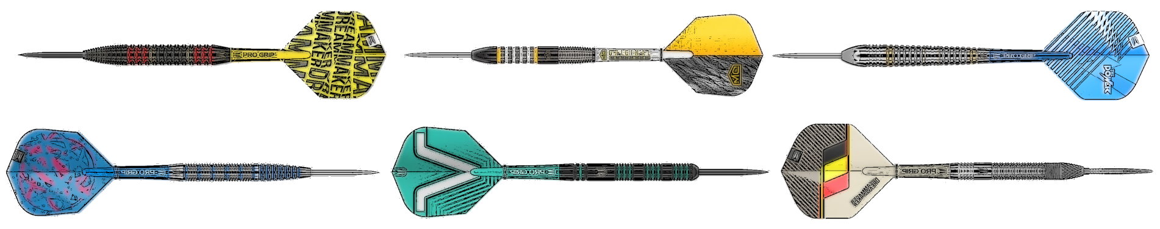
Automated Darts Scoring and Intelligent Shot Recommendation System
Alfred Carpenter

Slide 2
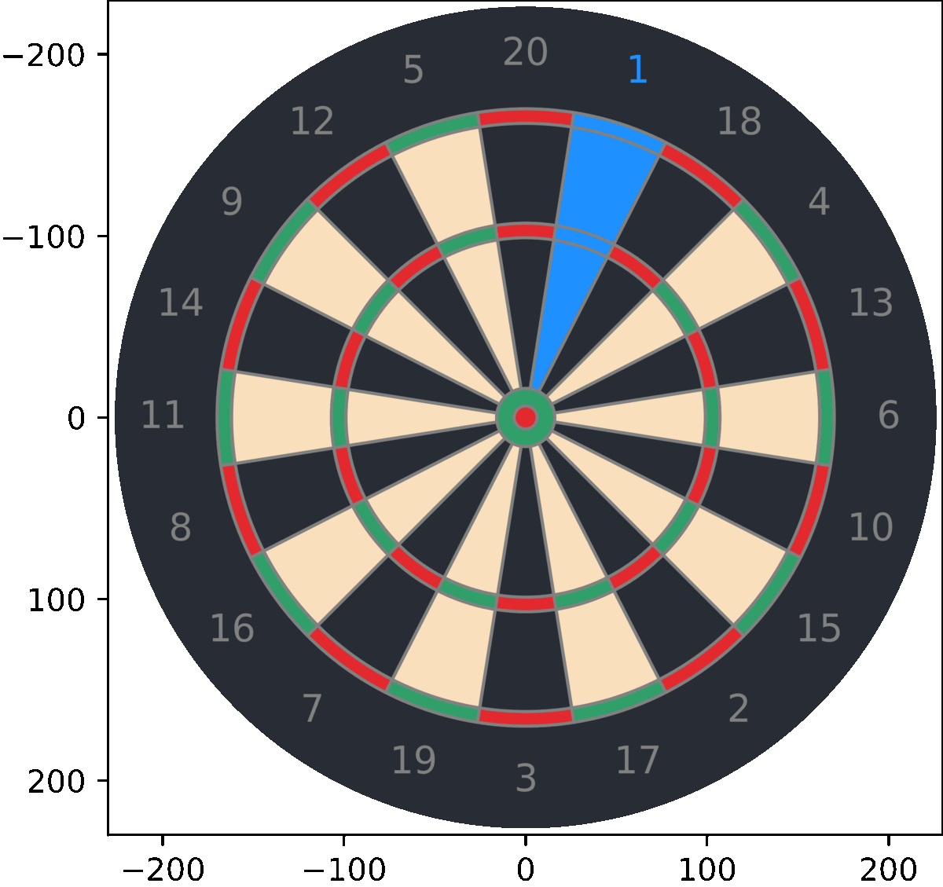
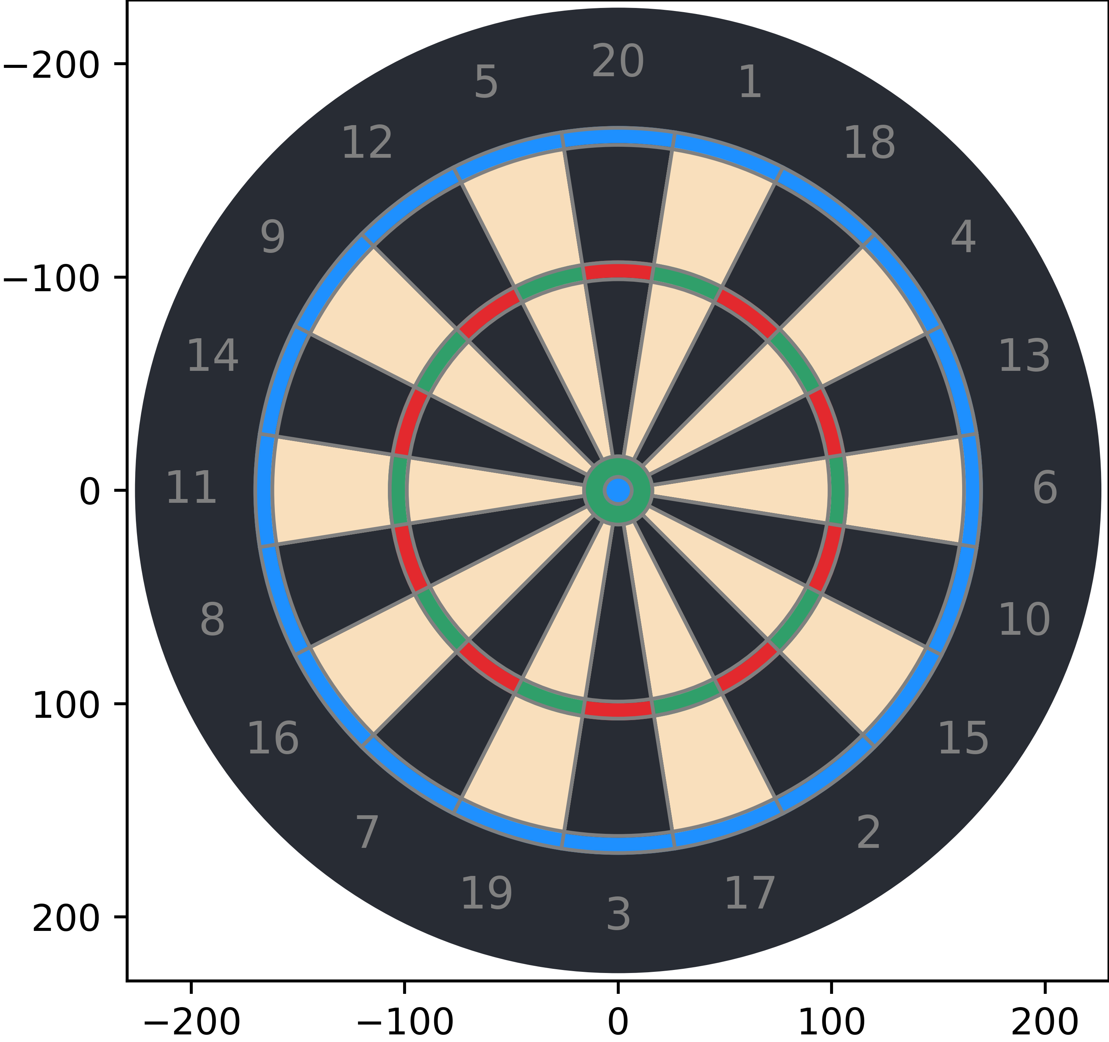
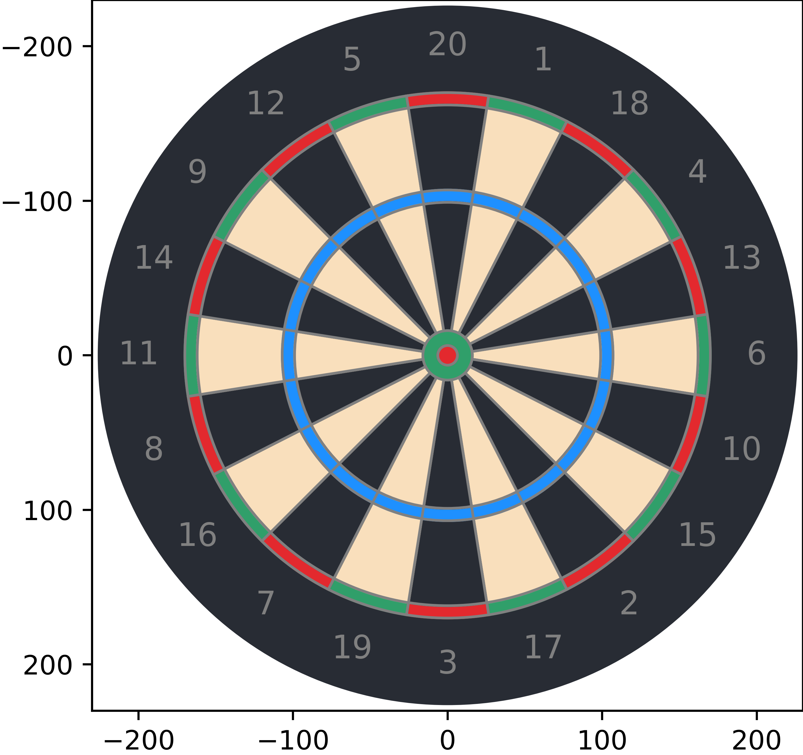
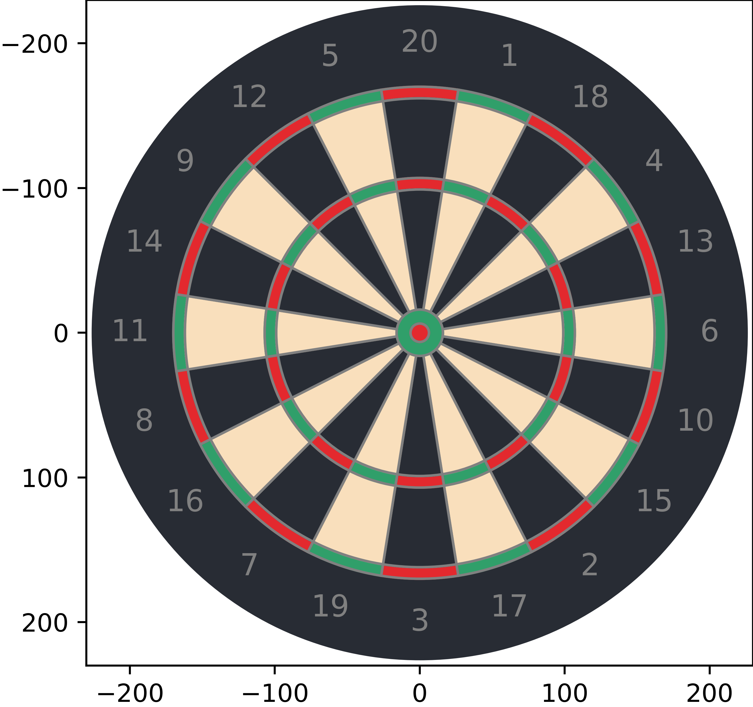
The Dartboard
20 Segments:
The board is divided into sections numbered from 1 to 20, each representing a different score.
Doubles Ring:
The narrow ring around the outer edge of the dartboard doubles the score of the segment it is contained in.
Triples Ring:
The even narrower ring located inside the doubles ring triples the score of the segment it is contained in.
Inner Bullseye:
The smallest central circle on the dartboard, worth 50 points.
Outer Bullseye:
The larger circle surrounding the inner bullseye, worth 25 points.
Double regions
Tripple regions

Slide 3
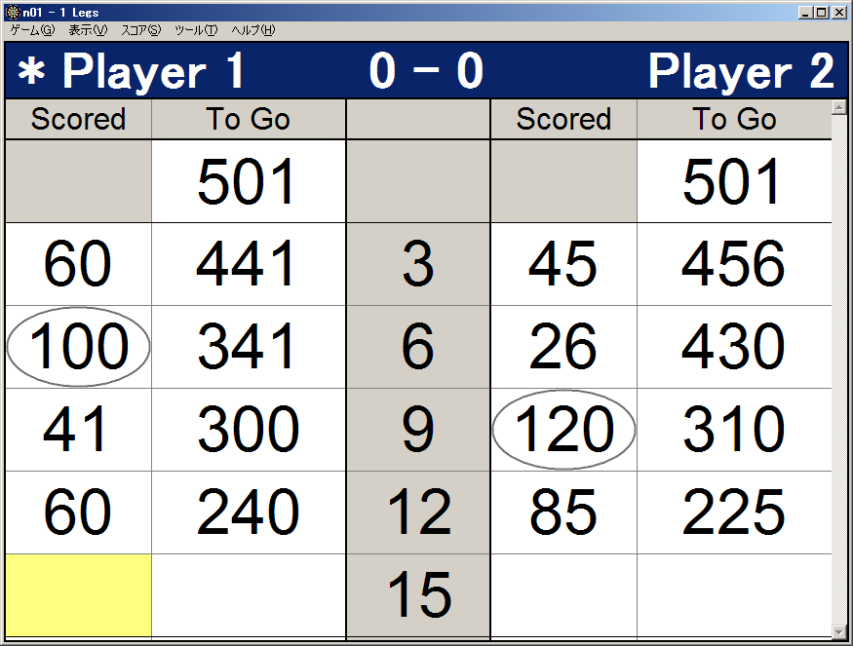
The Game of Darts
We are considering games following the x01 format:
The game begins with a predetermined number of points, i.e., 301, 501, 701, 901, and 1101.
Objective:
Players aim to reduce their score to exactly 0.
The first player to achieve this goal wins the game.
Gameplay:
Each player takes turns throwing three darts per round.
Scoring Rules:
Players must finish with a double to win.
Going below zero results in a "BUST," requiring players to restart from their previous round's score.

Slide 4

Problem Statement
Scoring games can be difficult and daunting, especially for new players.
Existing automated scoring systems exist but lack insightful analytics for player improvement.
Current research into optimal strategies based on skill level is theoretical and impractical.

Slide 5
Aims
What if we could develop an automated system for scoring darts games, and subsequently use this data to provide intelligent feedback?
This is possible by utilising a range of computer science topics, including:
Computer vision for dart detection.
Geometry for triangulating dart positions.
Probability theory for analysing player performance.
Web development for creating a scoring application.

Slide 6
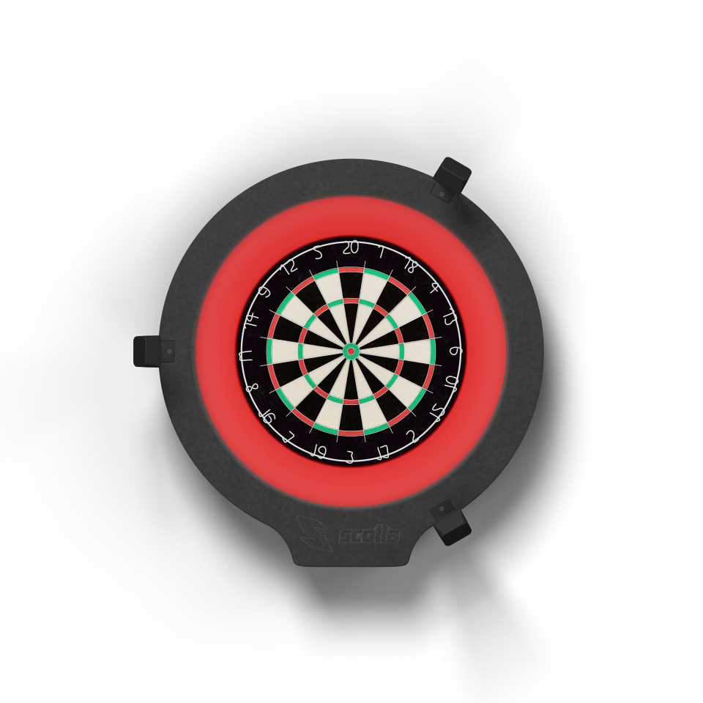
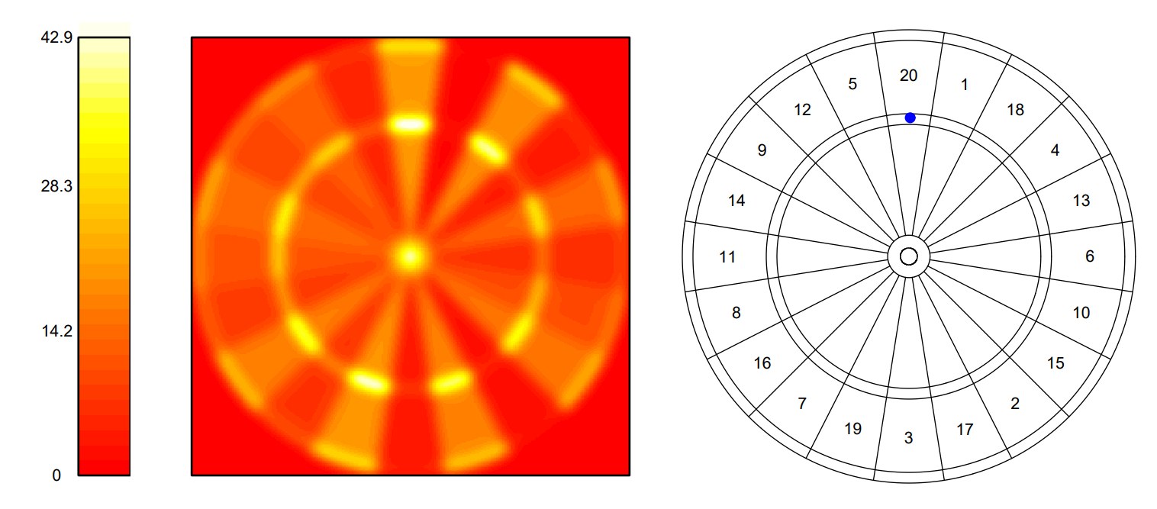
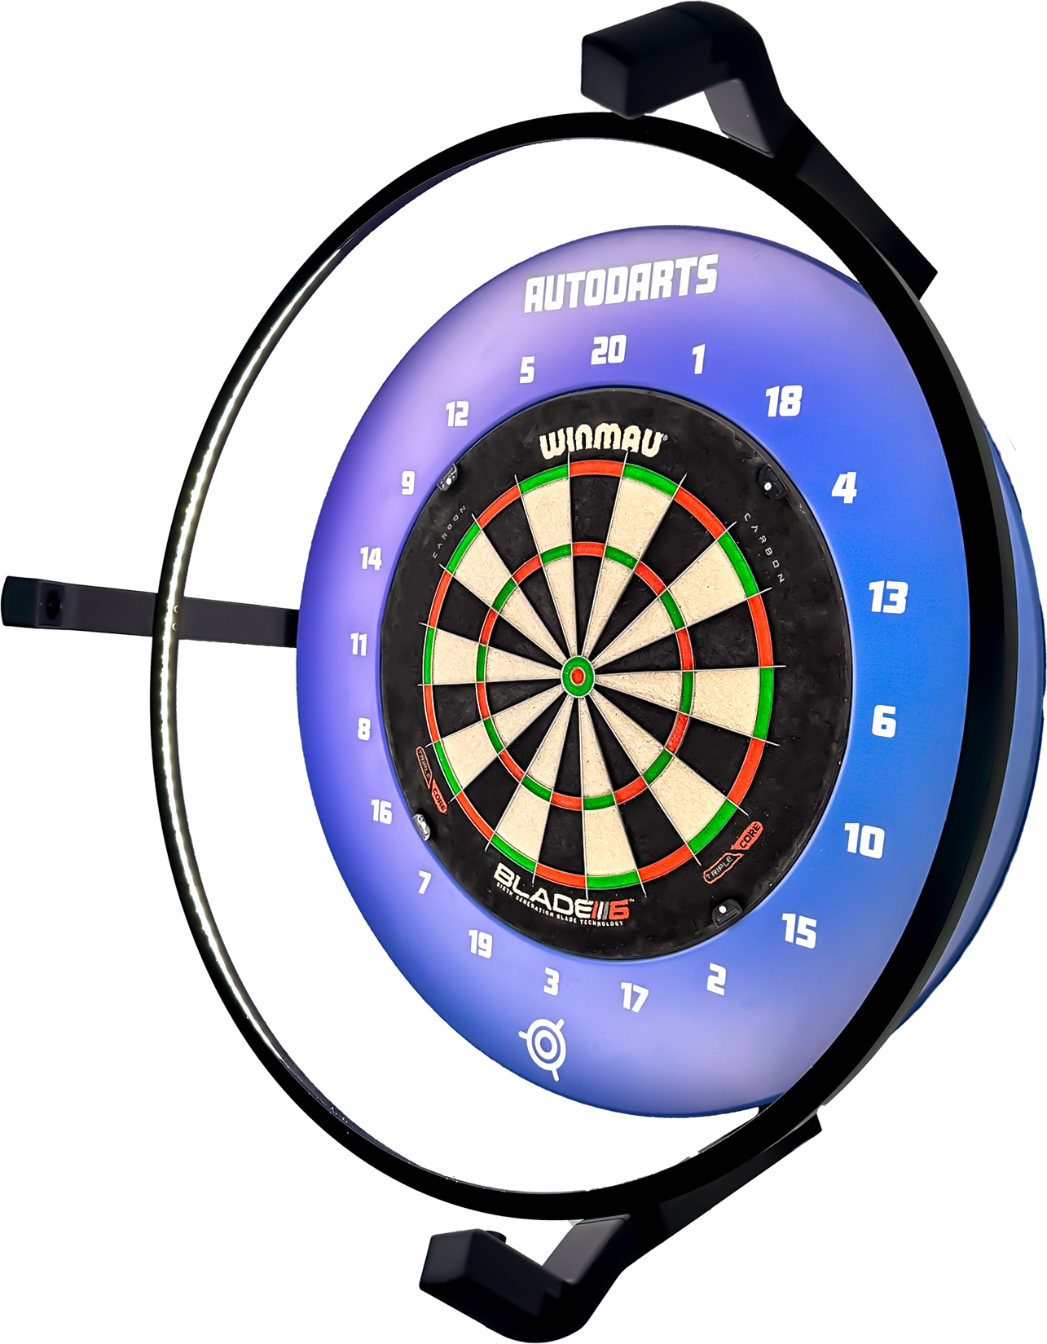
Existing Systems
A Statistician Plays Darts
Ryan J. Tibshirani, Andrew Price, Jonathan Taylor
Scolia
AutoDarts
However, having a player record the position of each throw would be too time-consuming and prone to measurement error. Also, few players would want to do this for a large number of throws.
Tibshirani, R.J., Price, A. and Taylor, J. (2010) ‘A statistician plays darts’, Journal of the Royal Statistical Society.
Available at: https://doi.org/10.1111/j.1467-985x.2010.00651.x.

Slide 7
Objectives
Dart Detection
Develop a system to detect when a dart has hit the dartboard.
Position Calculation
Implement algorithms to calculate the position of a dart on the board.
Extend to detect multiple darts.
Aim Variance Calculation
Develop algorithms to calculate the variance in a player's aim.
Optimal Shot Recommendation
Design an algorithm to calculate the target position on the board that maximises a player’s expected score.
Calculate the optimal aiming location to maximise the probability of checking out.
Scoring Application
Create a graphical interface to interact with the system.

Slide 8
Project Management
1 | Dart Detection
 | Dart Detection
 | Multi Dart Detection
 | End of Visit Detection
 | Triangulation
 | Calibration and Positioning
2 | Shot Recommendation
 | Standard Deviation
 | Skewed Deviation
 | Aiming Algorithm to Maximise Score
 | Aiming Algorithm to Maximise Probability of Checkout in 3 darts
 | Shot Recommendation
3 | General Development
 | Scoring
 | Game Play
 | Graphical Scoring Display
 | 2D Board Representation
 | 3D Board Representation

Slide 9

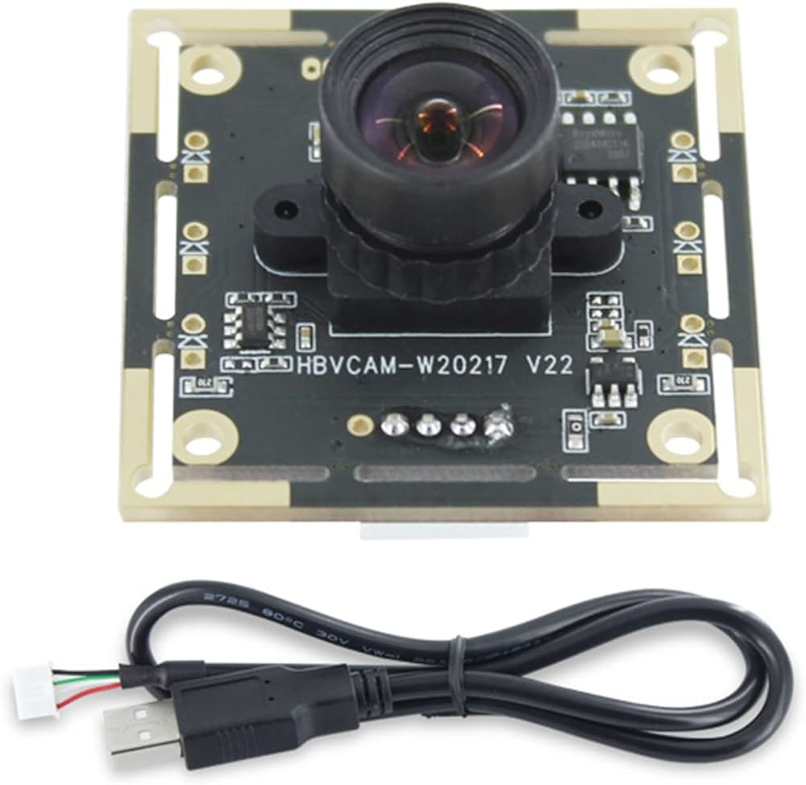



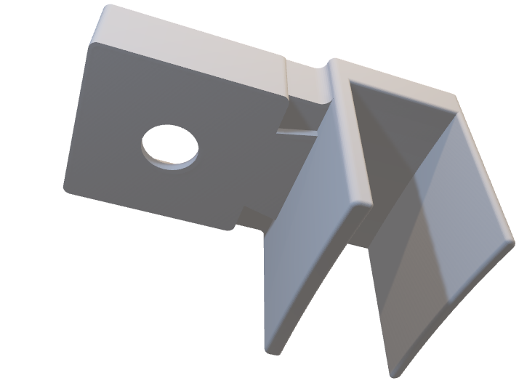
Tools

Slide 10
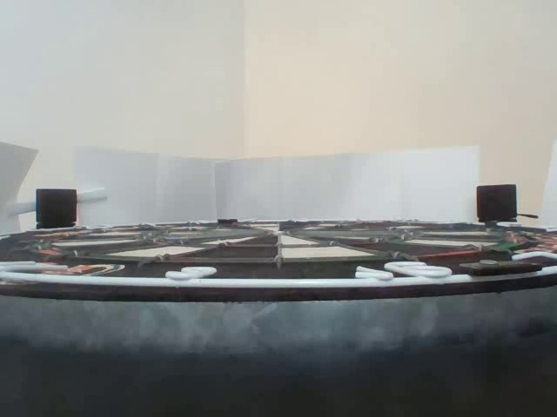
Dart Detection
Get image of blank board.

Slide 11
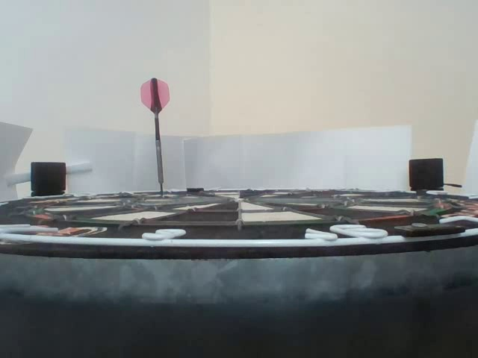
Dart Detection
Get image of blank board.
Get image containing dart.

Slide 12
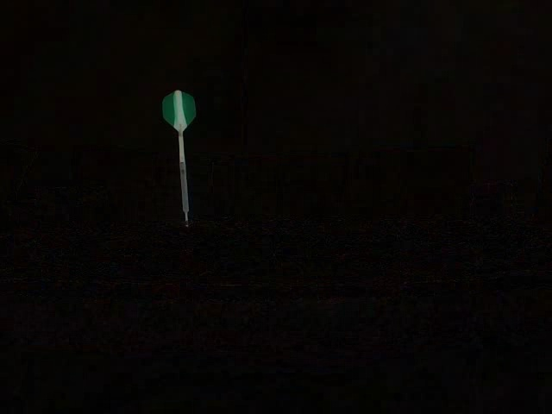
Dart Detection
Get image of blank board.
Get image containing dart.
Compute absolute difference.

Slide 13
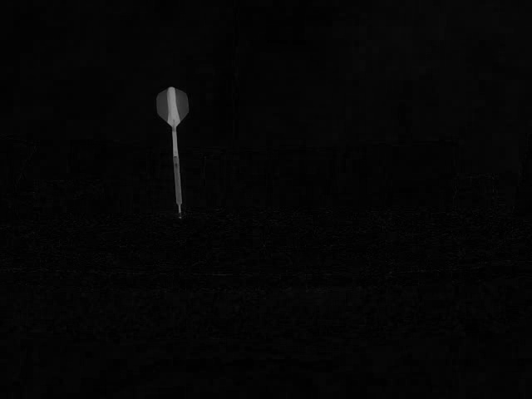
Dart Detection
Get image of blank board.
Get image containing dart.
Compute absolute difference.
Convert to grayscale.

Slide 14

Dart Detection
Get image of blank board.
Get image containing dart.
Compute absolute difference.
Convert to grayscale.
Blur the image

Slide 15
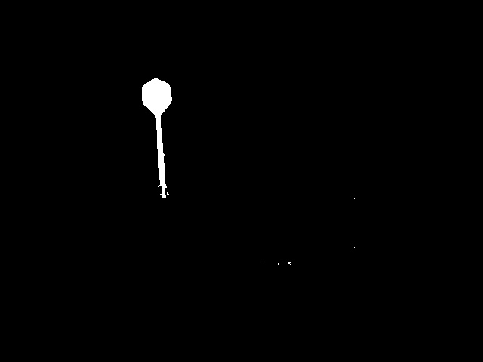
Dart Detection
Perform thresholding.

Slide 16

Dart Detection
Perform thresholding.
Perform morphological operations.

Slide 17
Dart Detection
Perform thresholding.
Perform morphological operations.
Locate largest connected component.

Slide 18
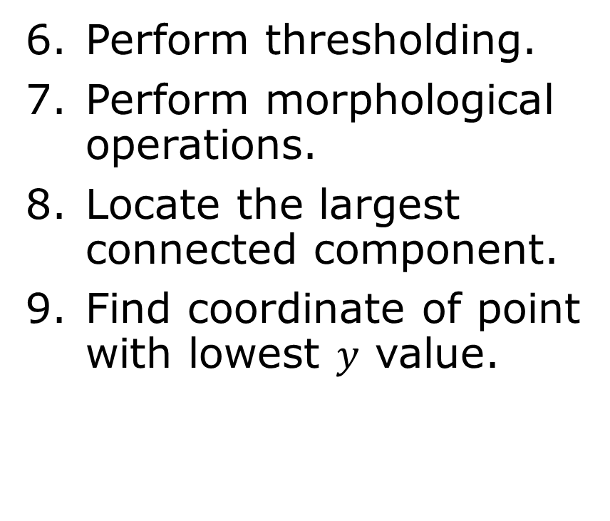
Dart Detection
Perform thresholding.
Perform morphological operations.
Locate the largest connected component.
Find coordinate of point with lowest $y$ value.

Slide 19
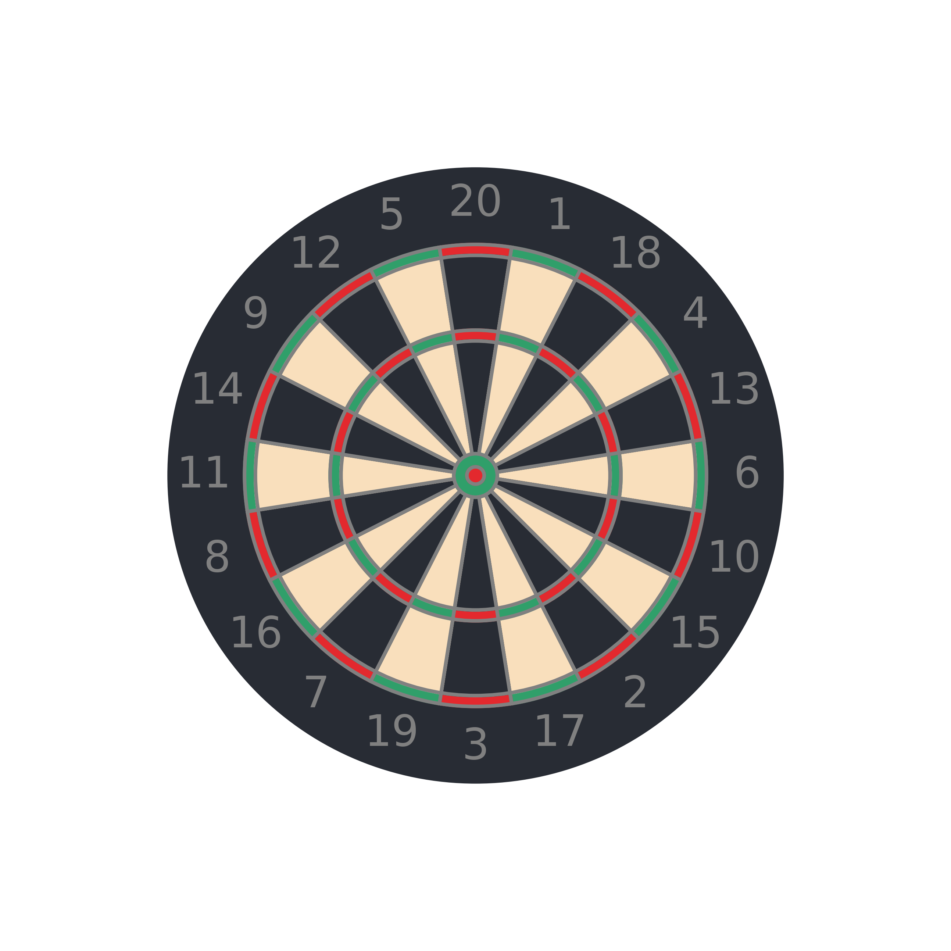
Positioning
Aim: locate the dart in the board.

Slide 20
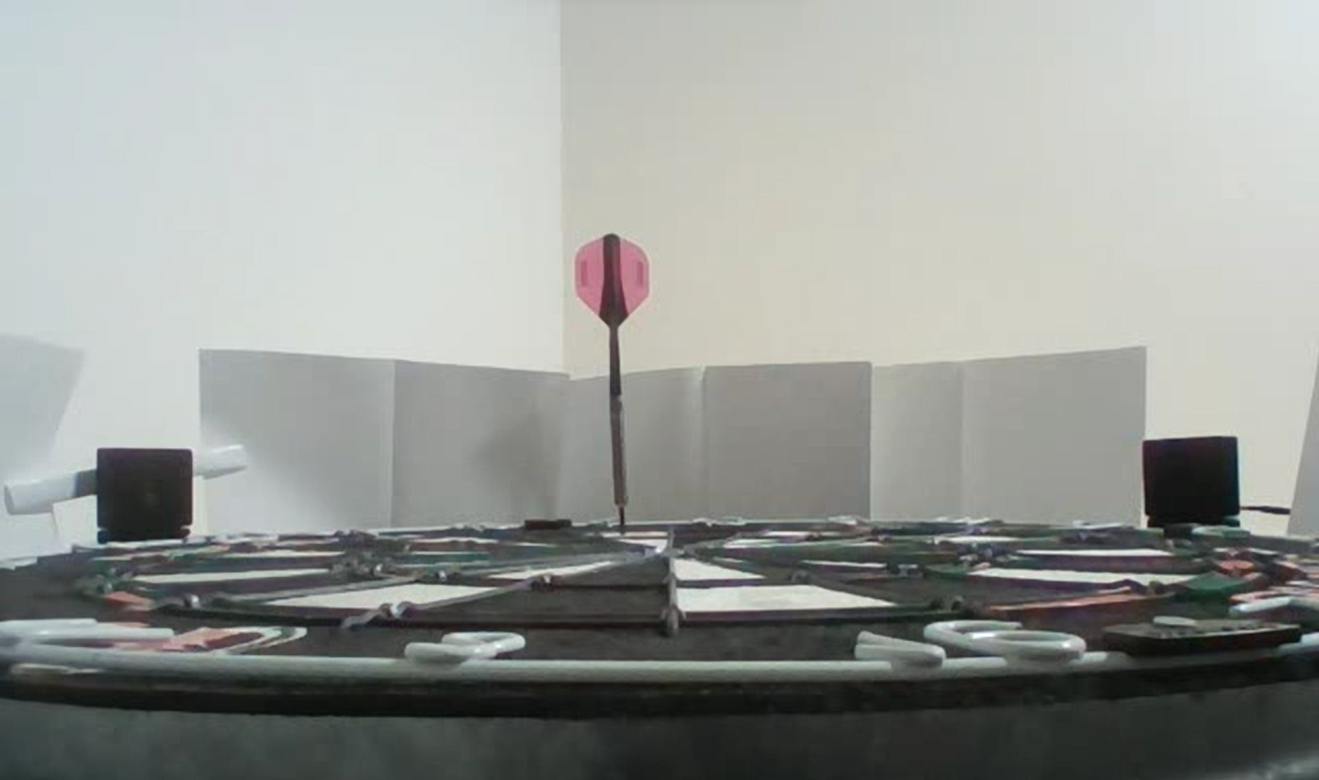
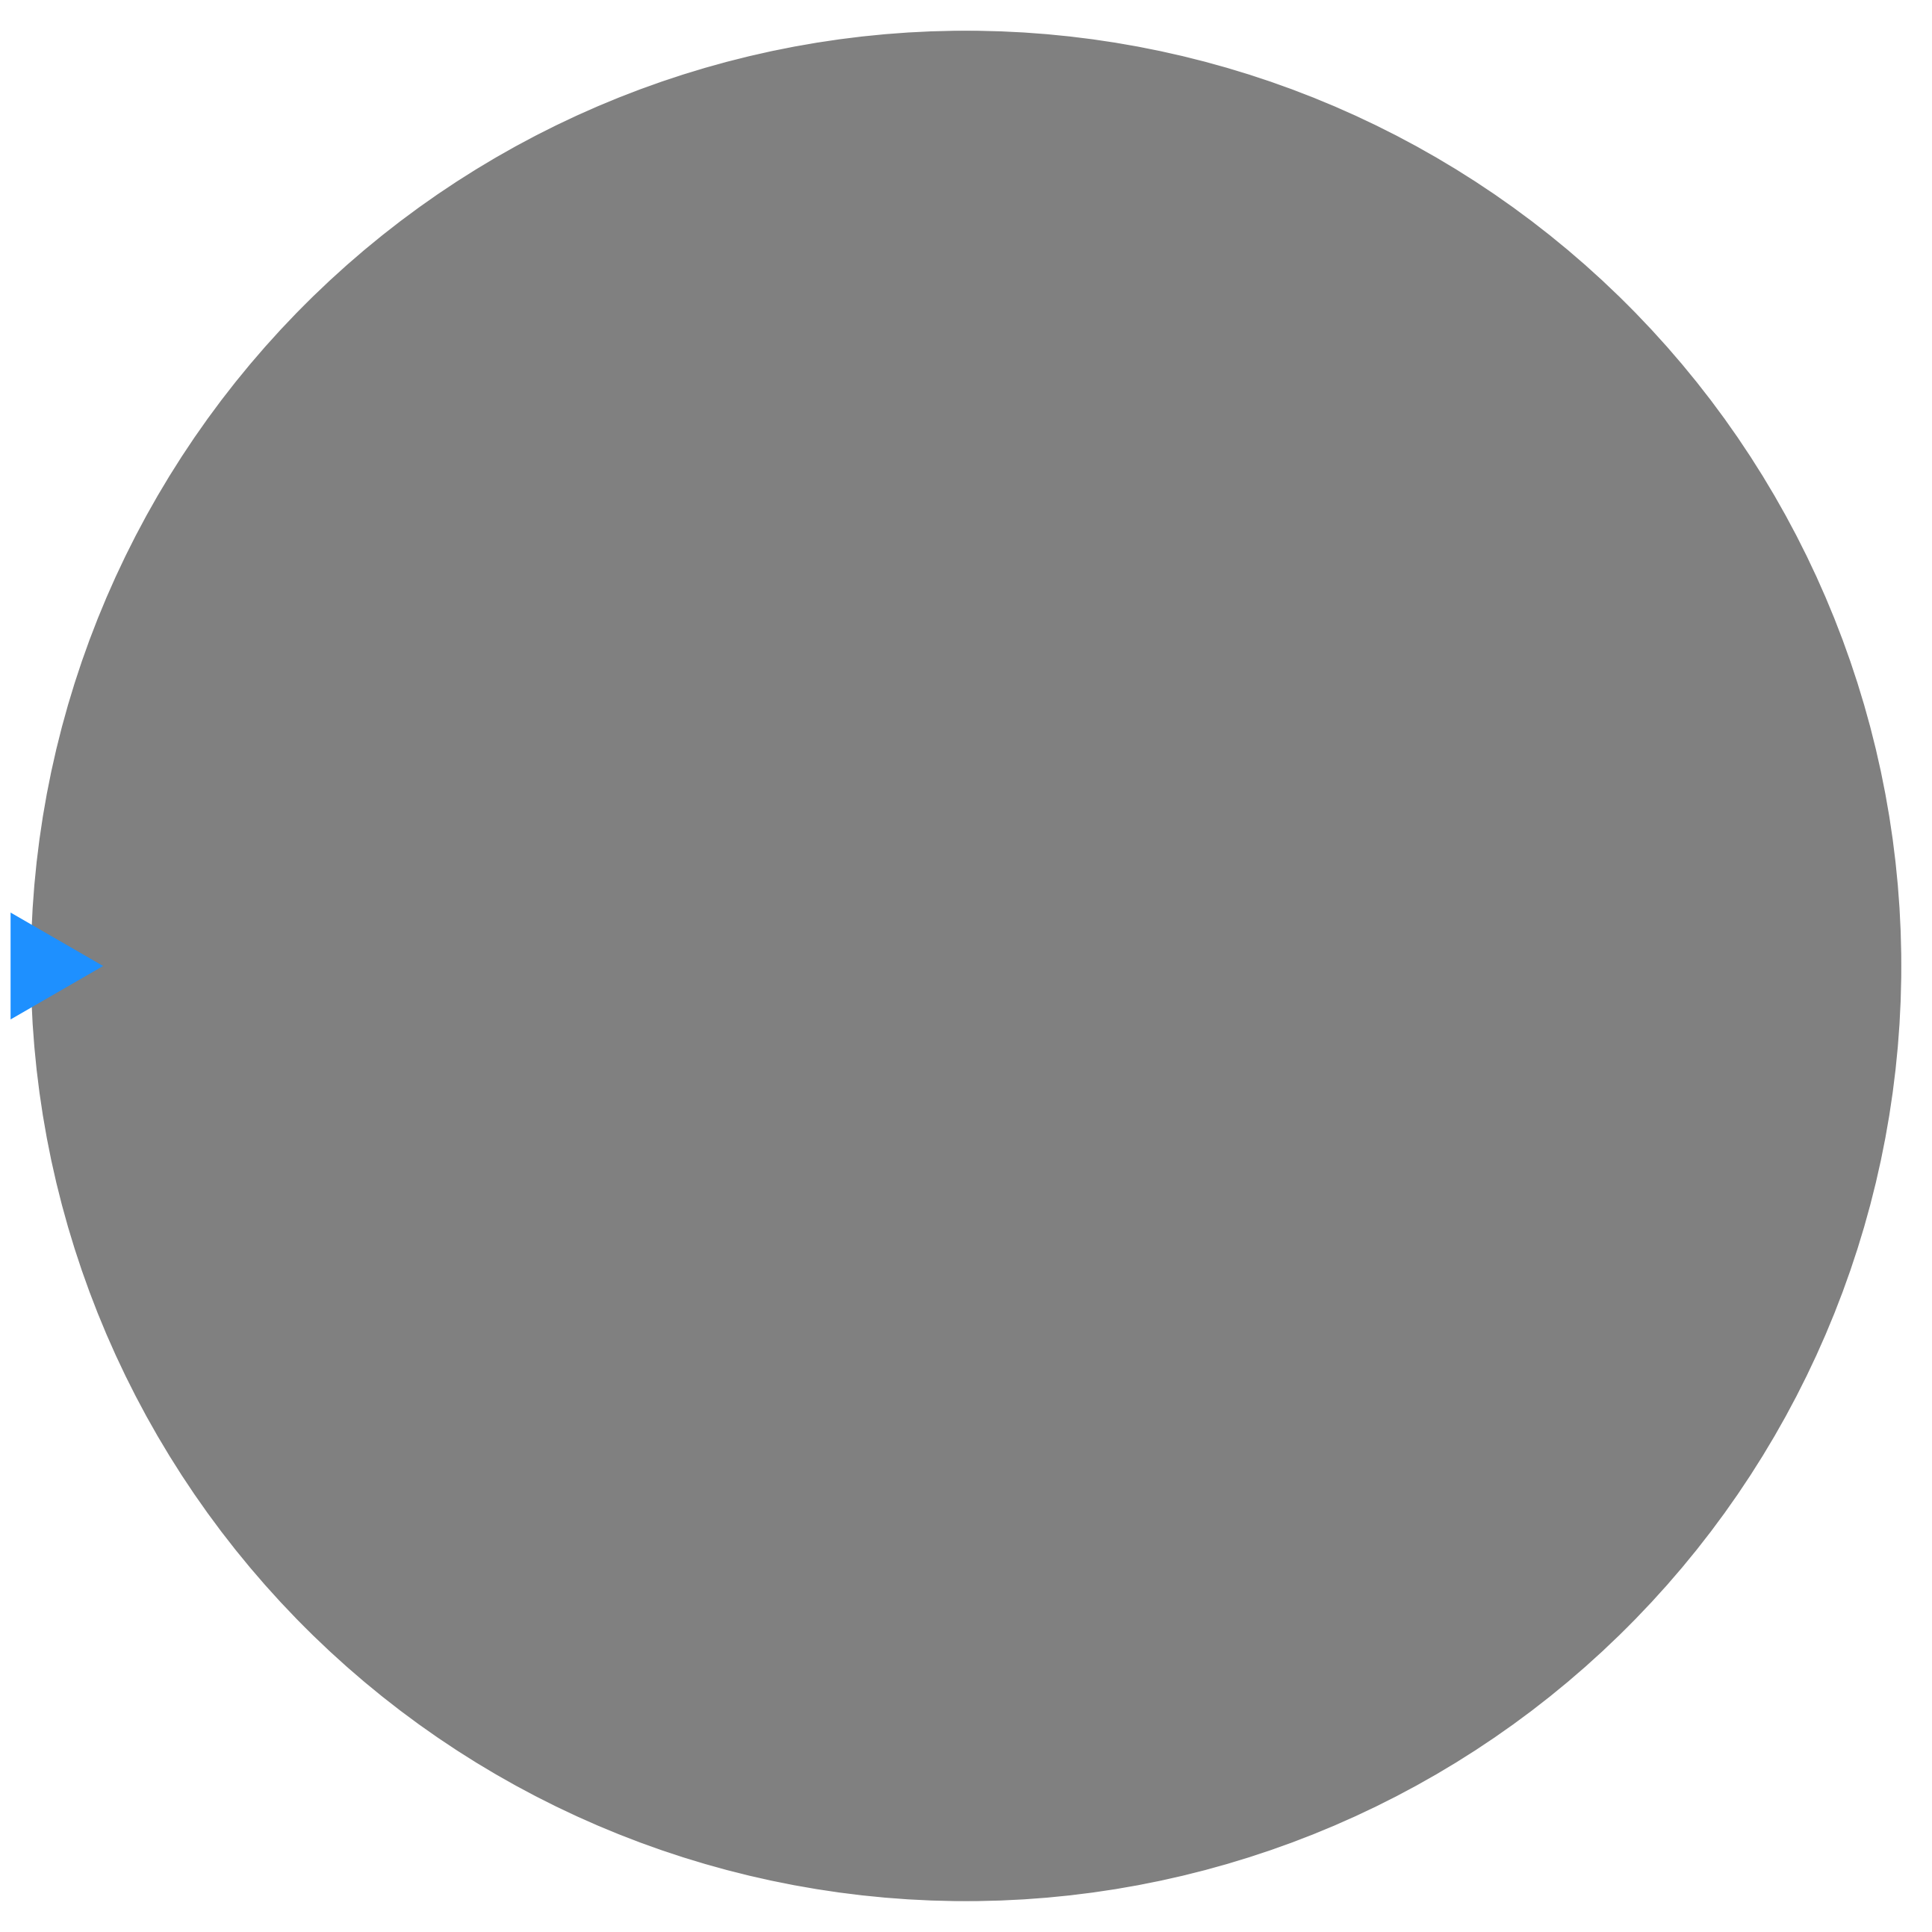
Positioning
Aim: locate the dart in the board.
Aim: locate the dart in the board.
Aim: map a point in image coordinates to a position on the board.

Slide 21
Positioning
Aim: locate the dart in the board.
Aim: map a point in image coordinates to a position on the board.
Detect the coordinate of the dart tip within the image.

Slide 22
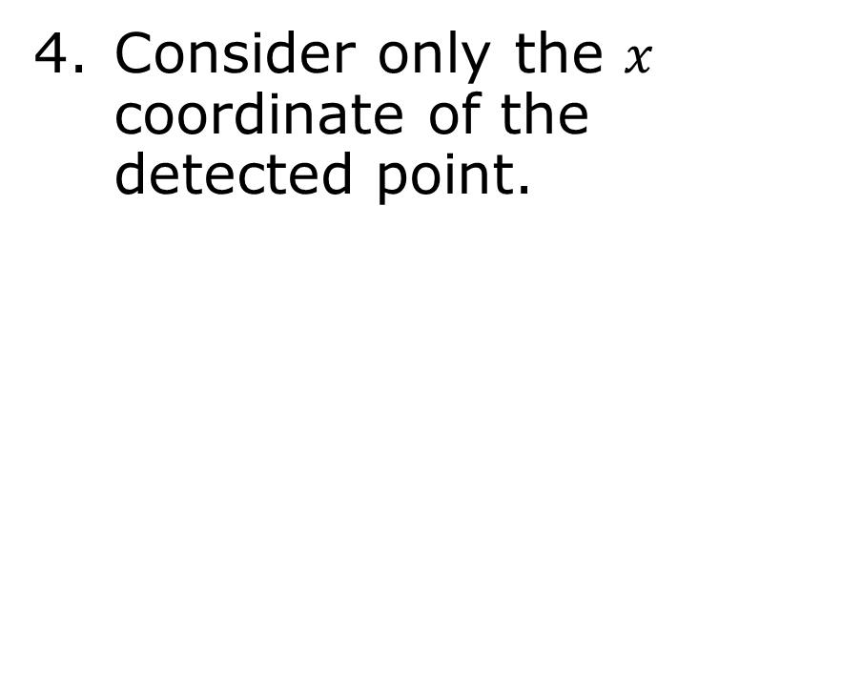
Positioning
Consider only the $x$ coordinate of the detected point.

Slide 23
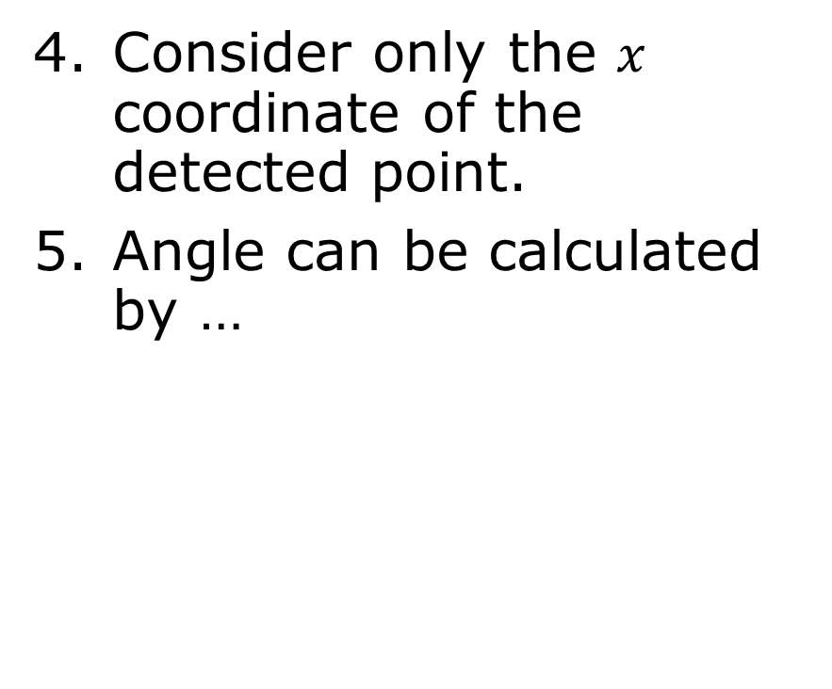
Positioning
Consider only the $x$ coordinate of the detected point.
Angle can be calculated by …

Slide 24
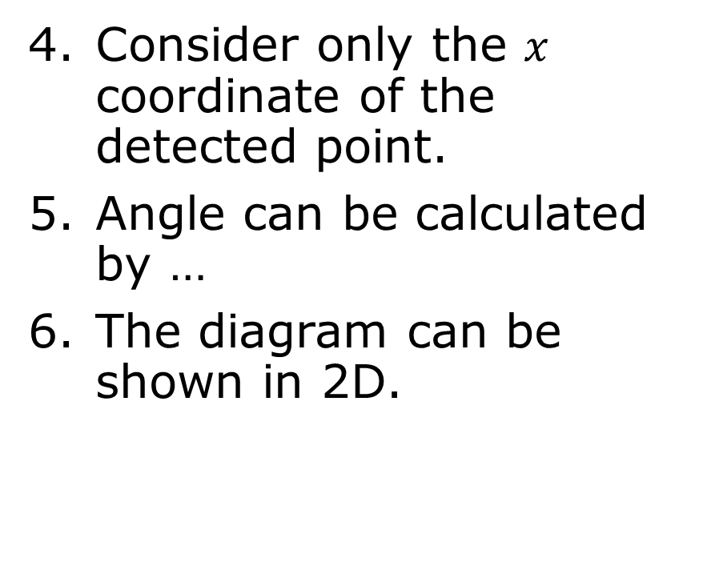
Positioning
Consider only the $x$ coordinate of the detected point.
Angle can be calculated by …
Consider only the $x$ coordinate of the detected point.
Angle can be calculated by …
The diagram can be shown in 2D.

Slide 25
Positioning
The dart, therefore, lies along this line.

Slide 26
Positioning
The dart, therefore, lies along this line.
The dart, therefore, lies along this line.
We may have to perform transformations to account for varying camera positions.

Slide 27
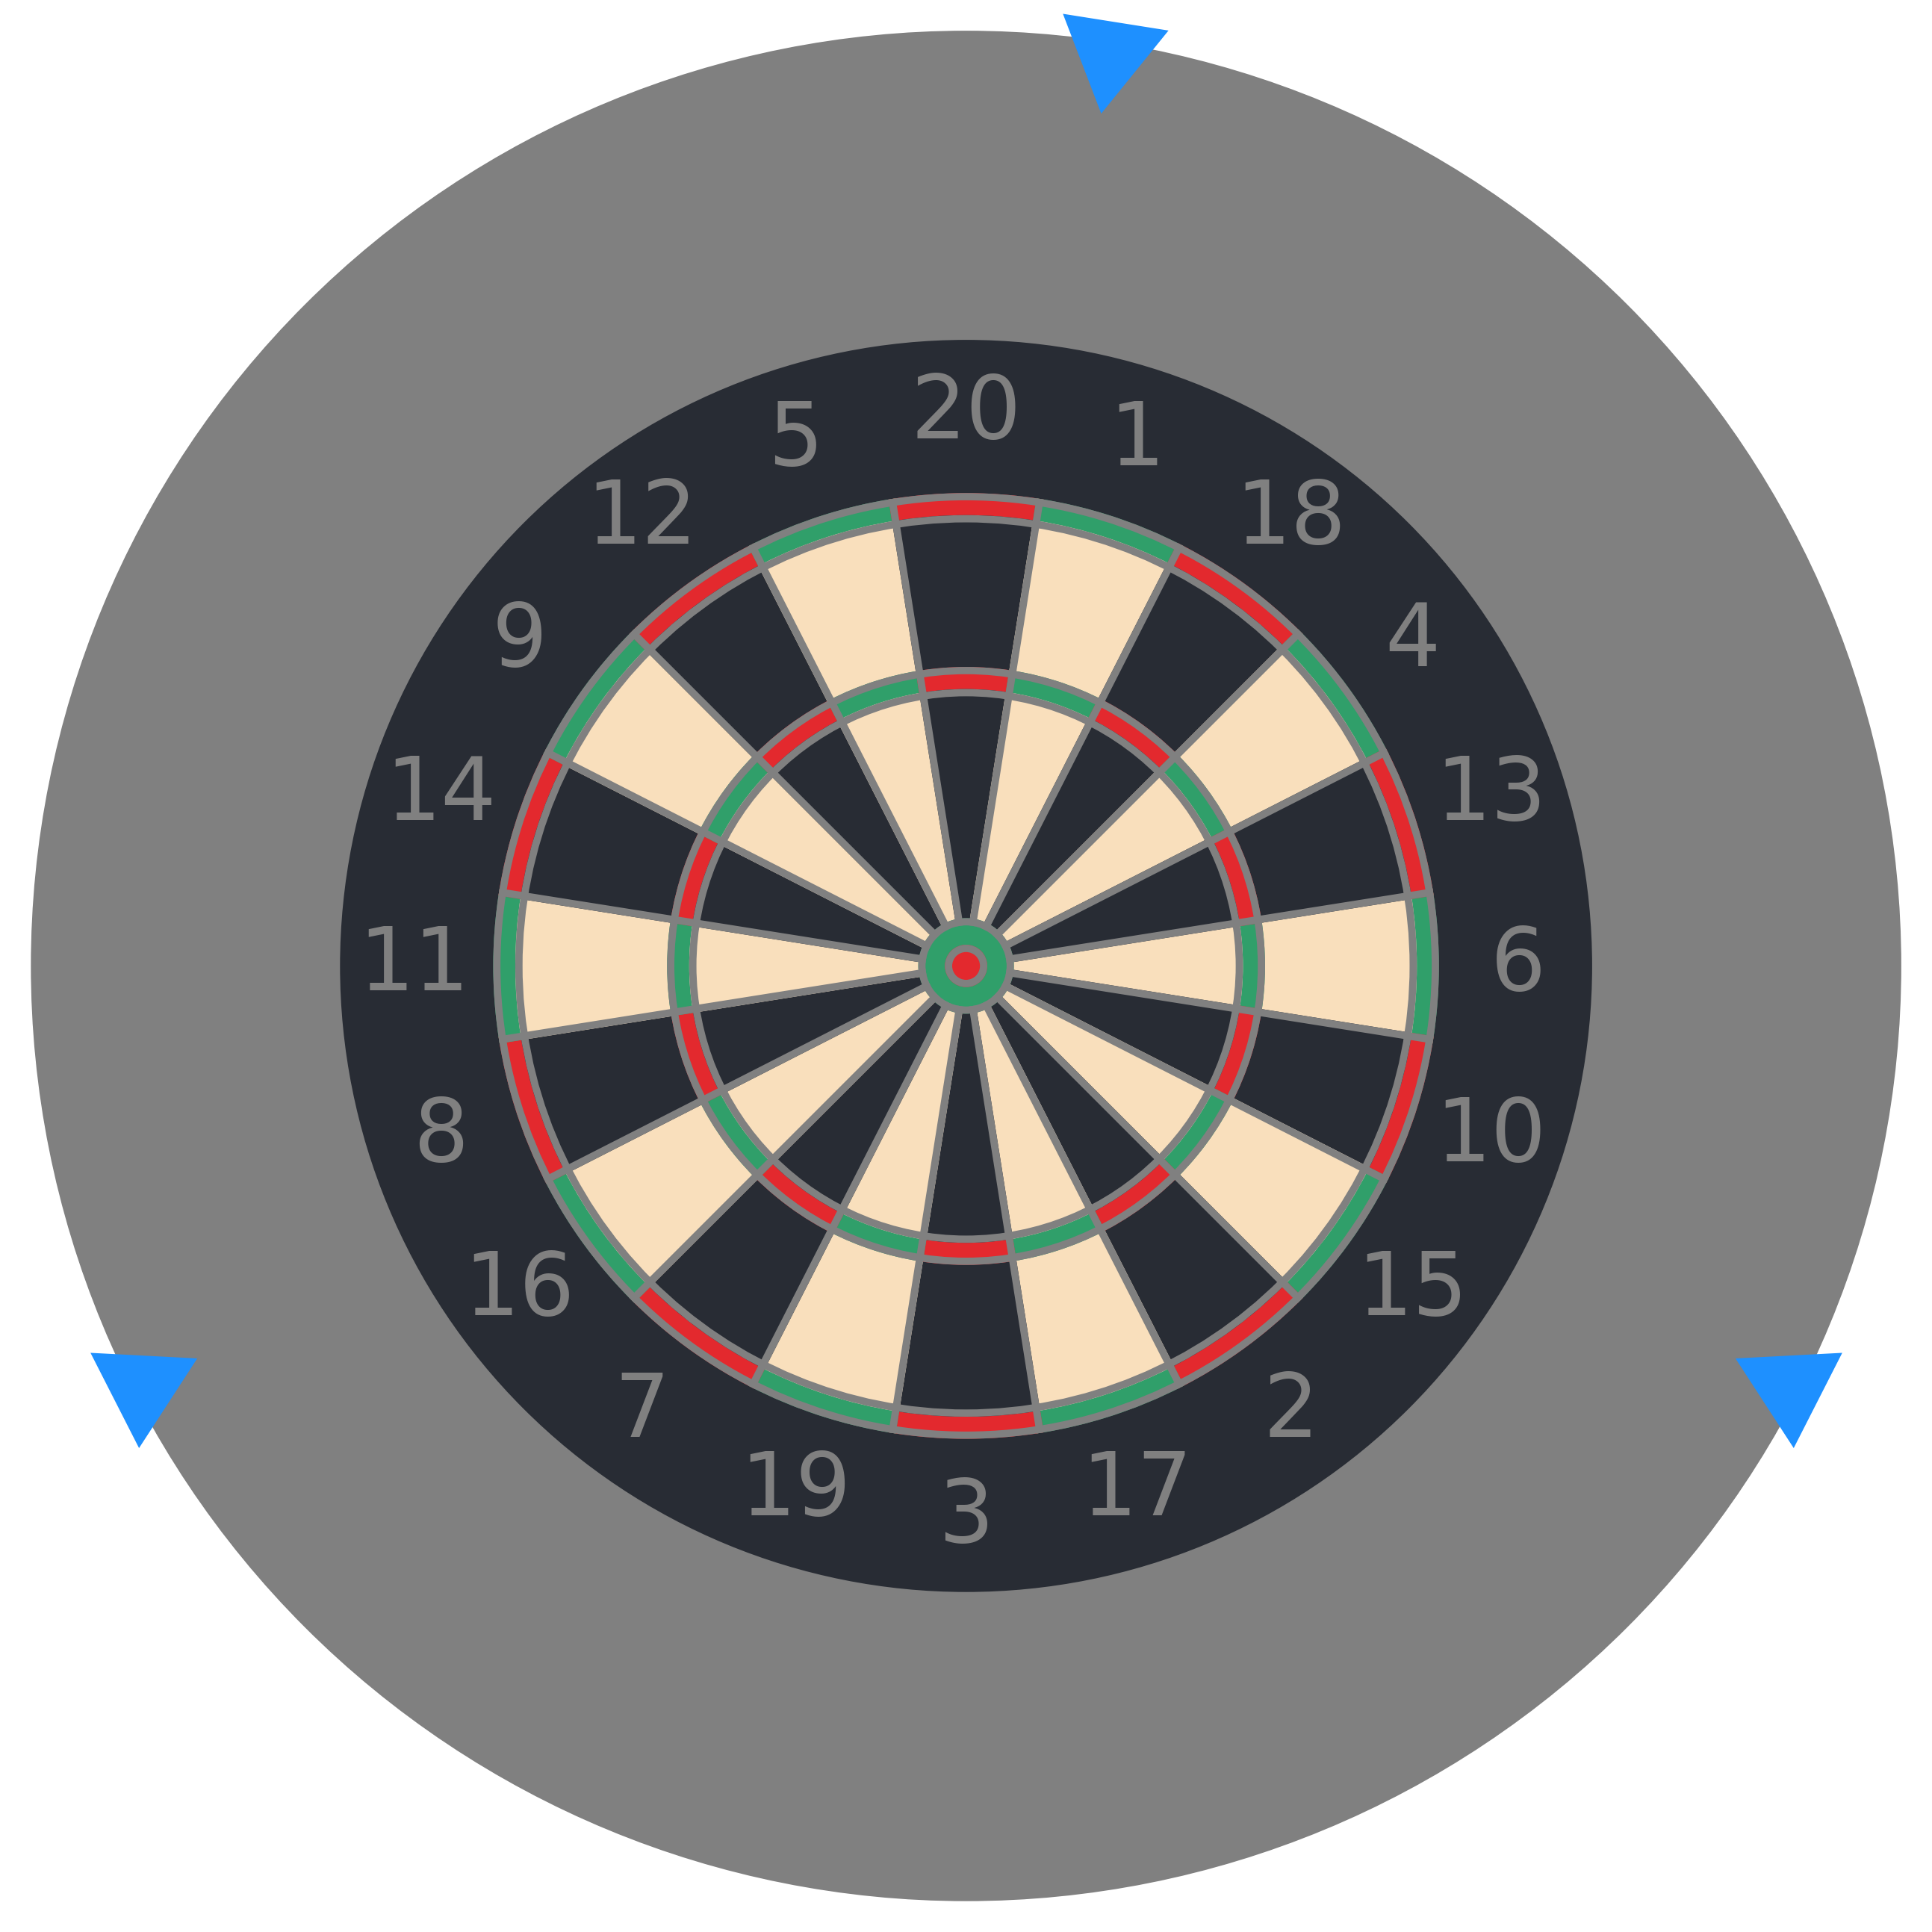
Positioning
Using two cameras, we can calculate the dart’s position on the board. Three cameras prevent darts from obstructing the view of other darts.

Slide 28
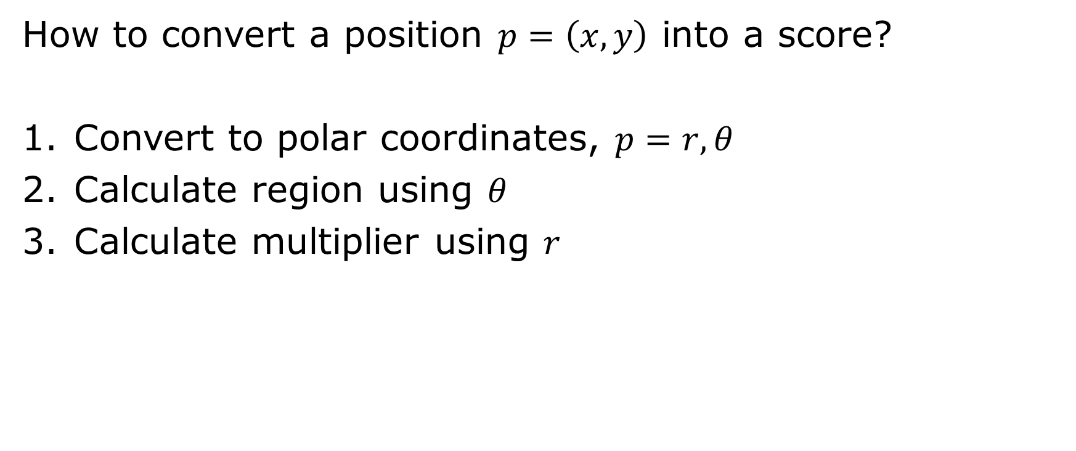
Scoring
How to convert a position $p=\left(x,y\right)$ into a score?
Convert to polar coordinates, $p=r, θ$
Calculate region using $θ$
Calculate multiplier using $r$

Slide 29
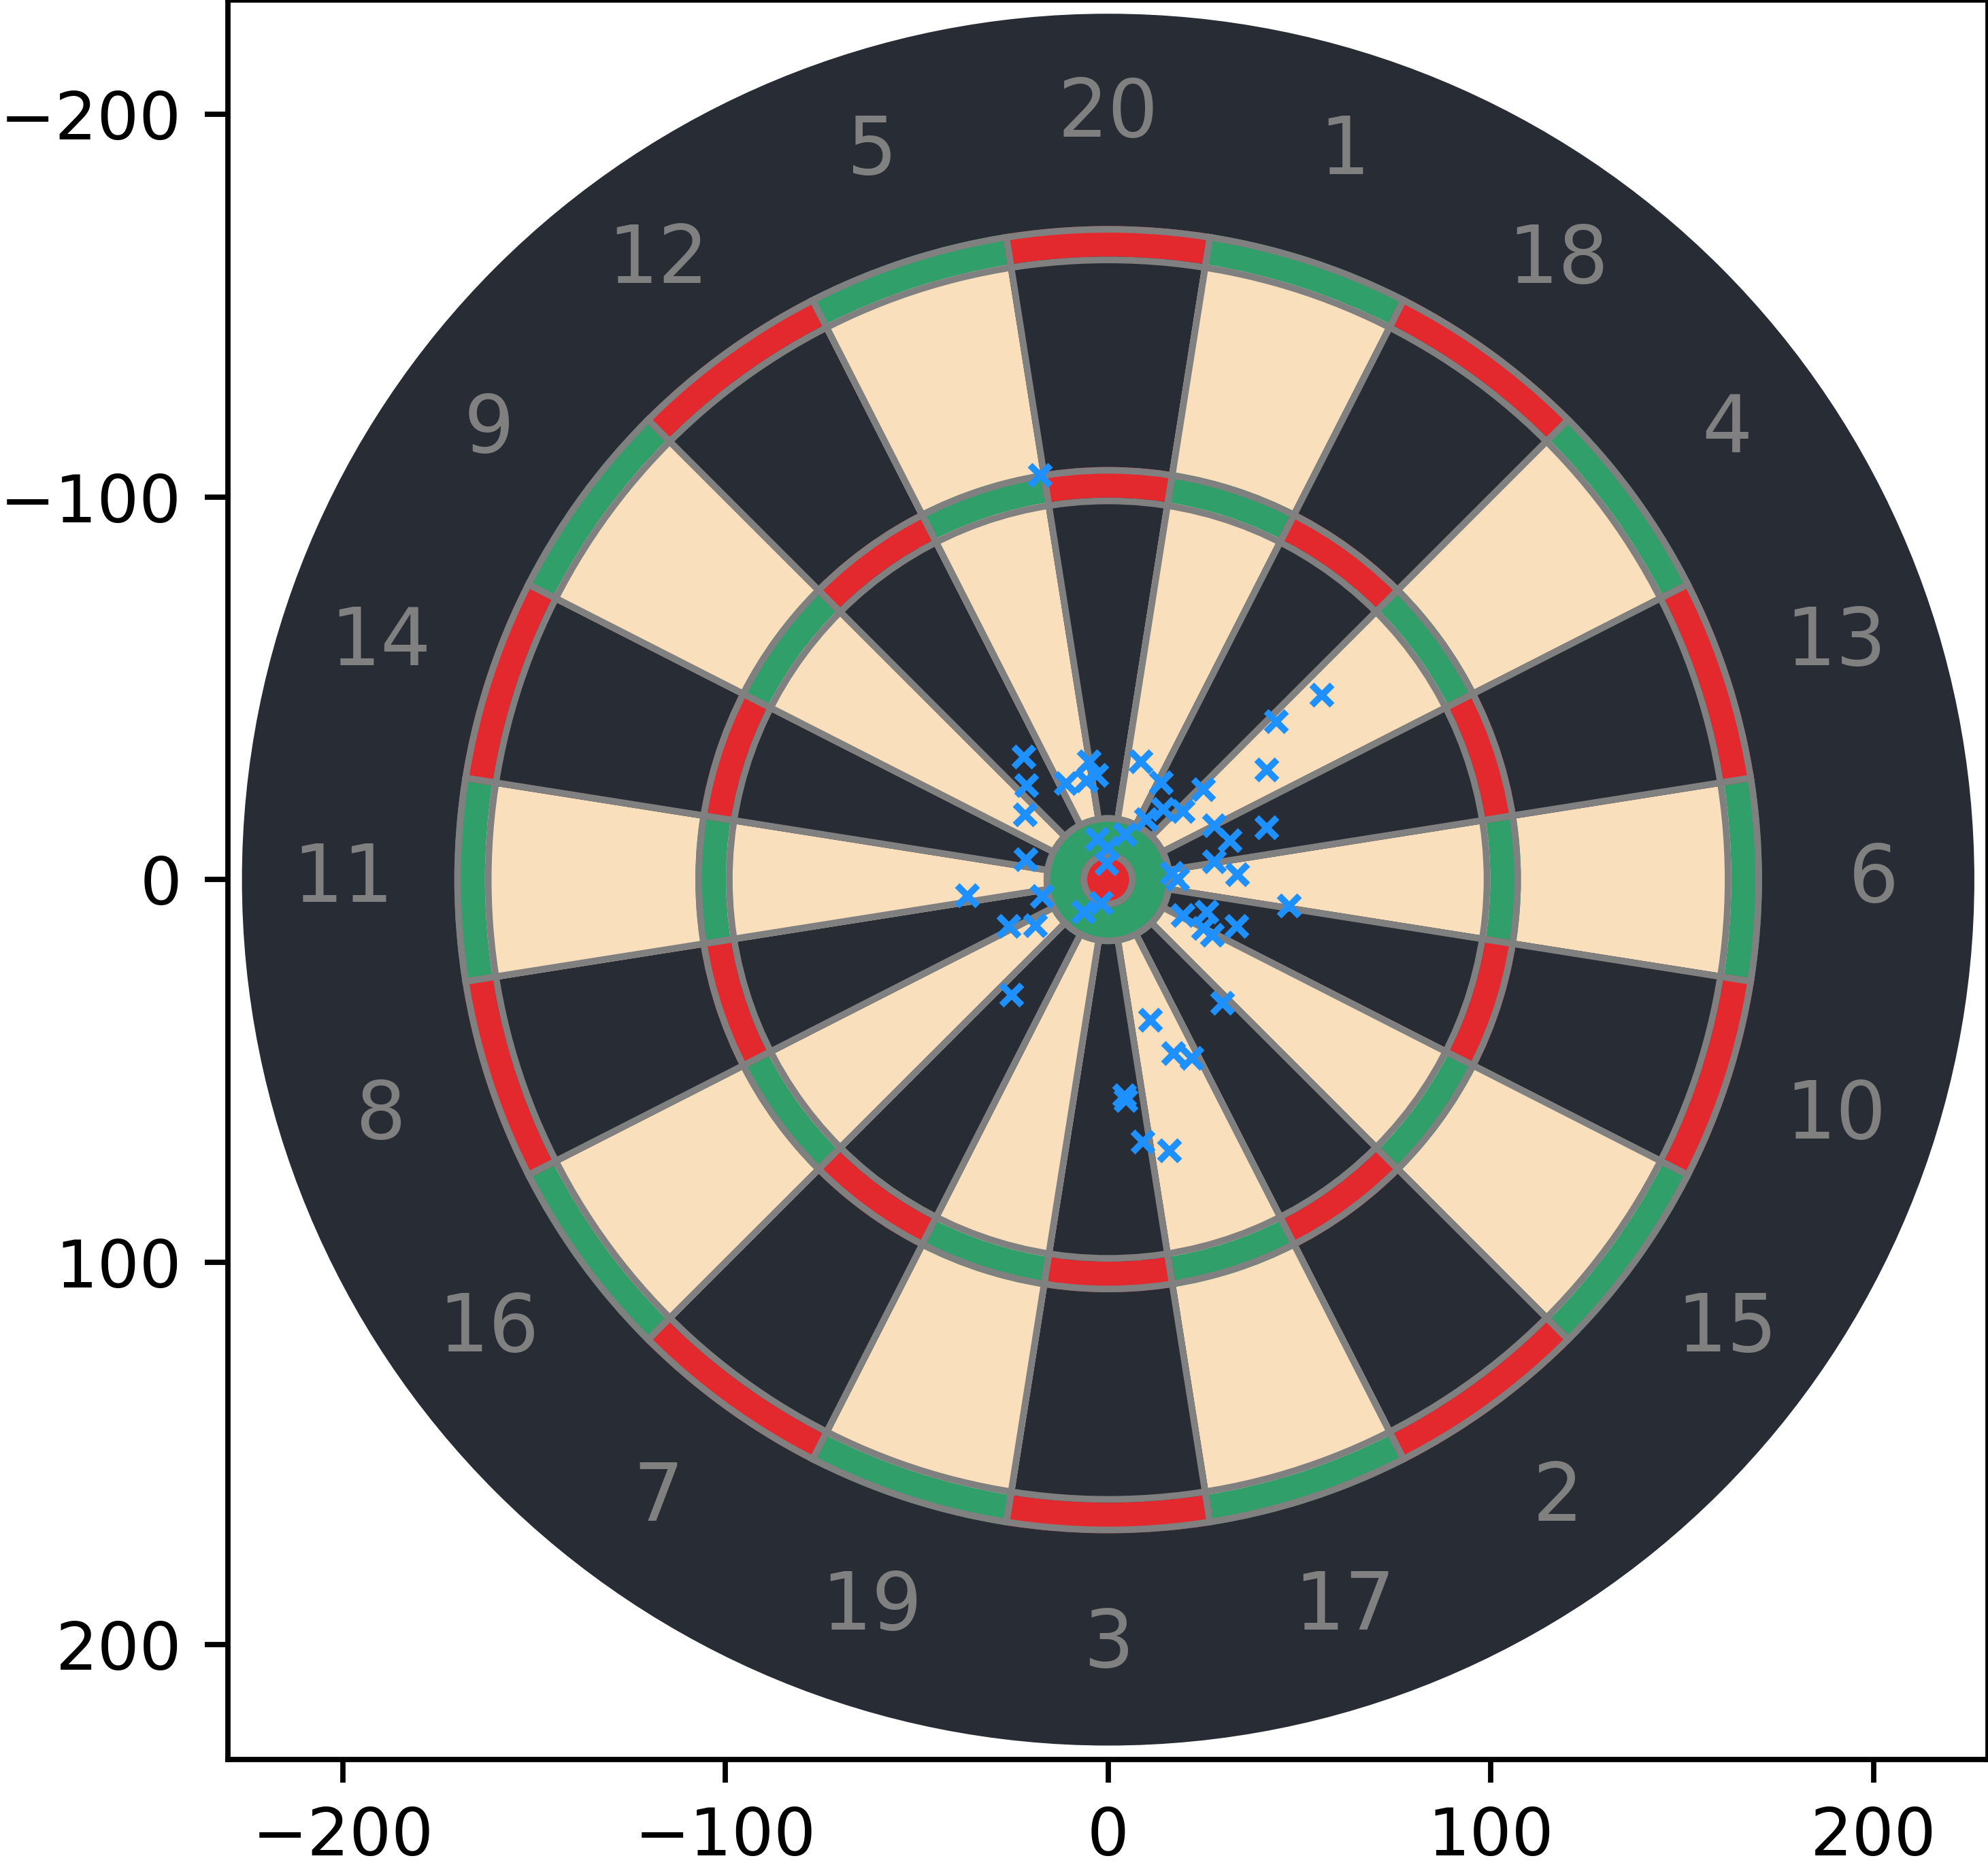
Calculating a Player’s Skill
Throw N darts aiming for the centre of the board.
Take their x and y coordinates.
Assume independence between horizontal and vertical distribution.
Calculate the distribution of these points.

Slide 30
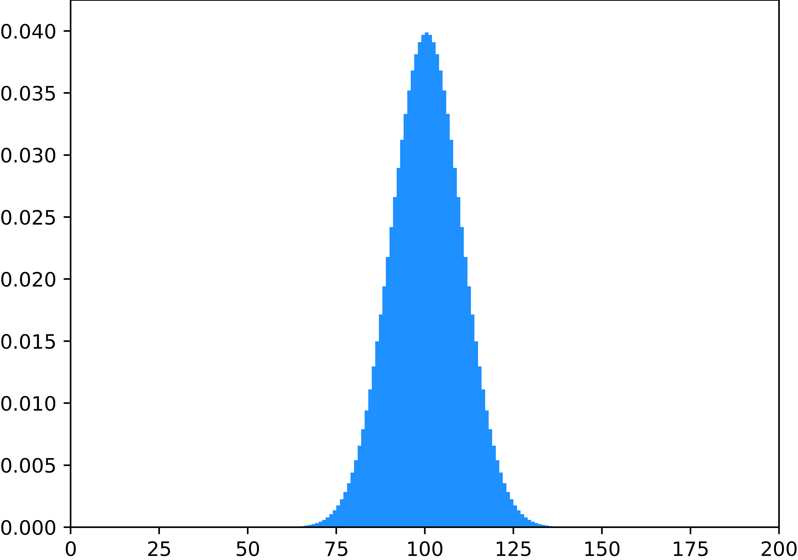
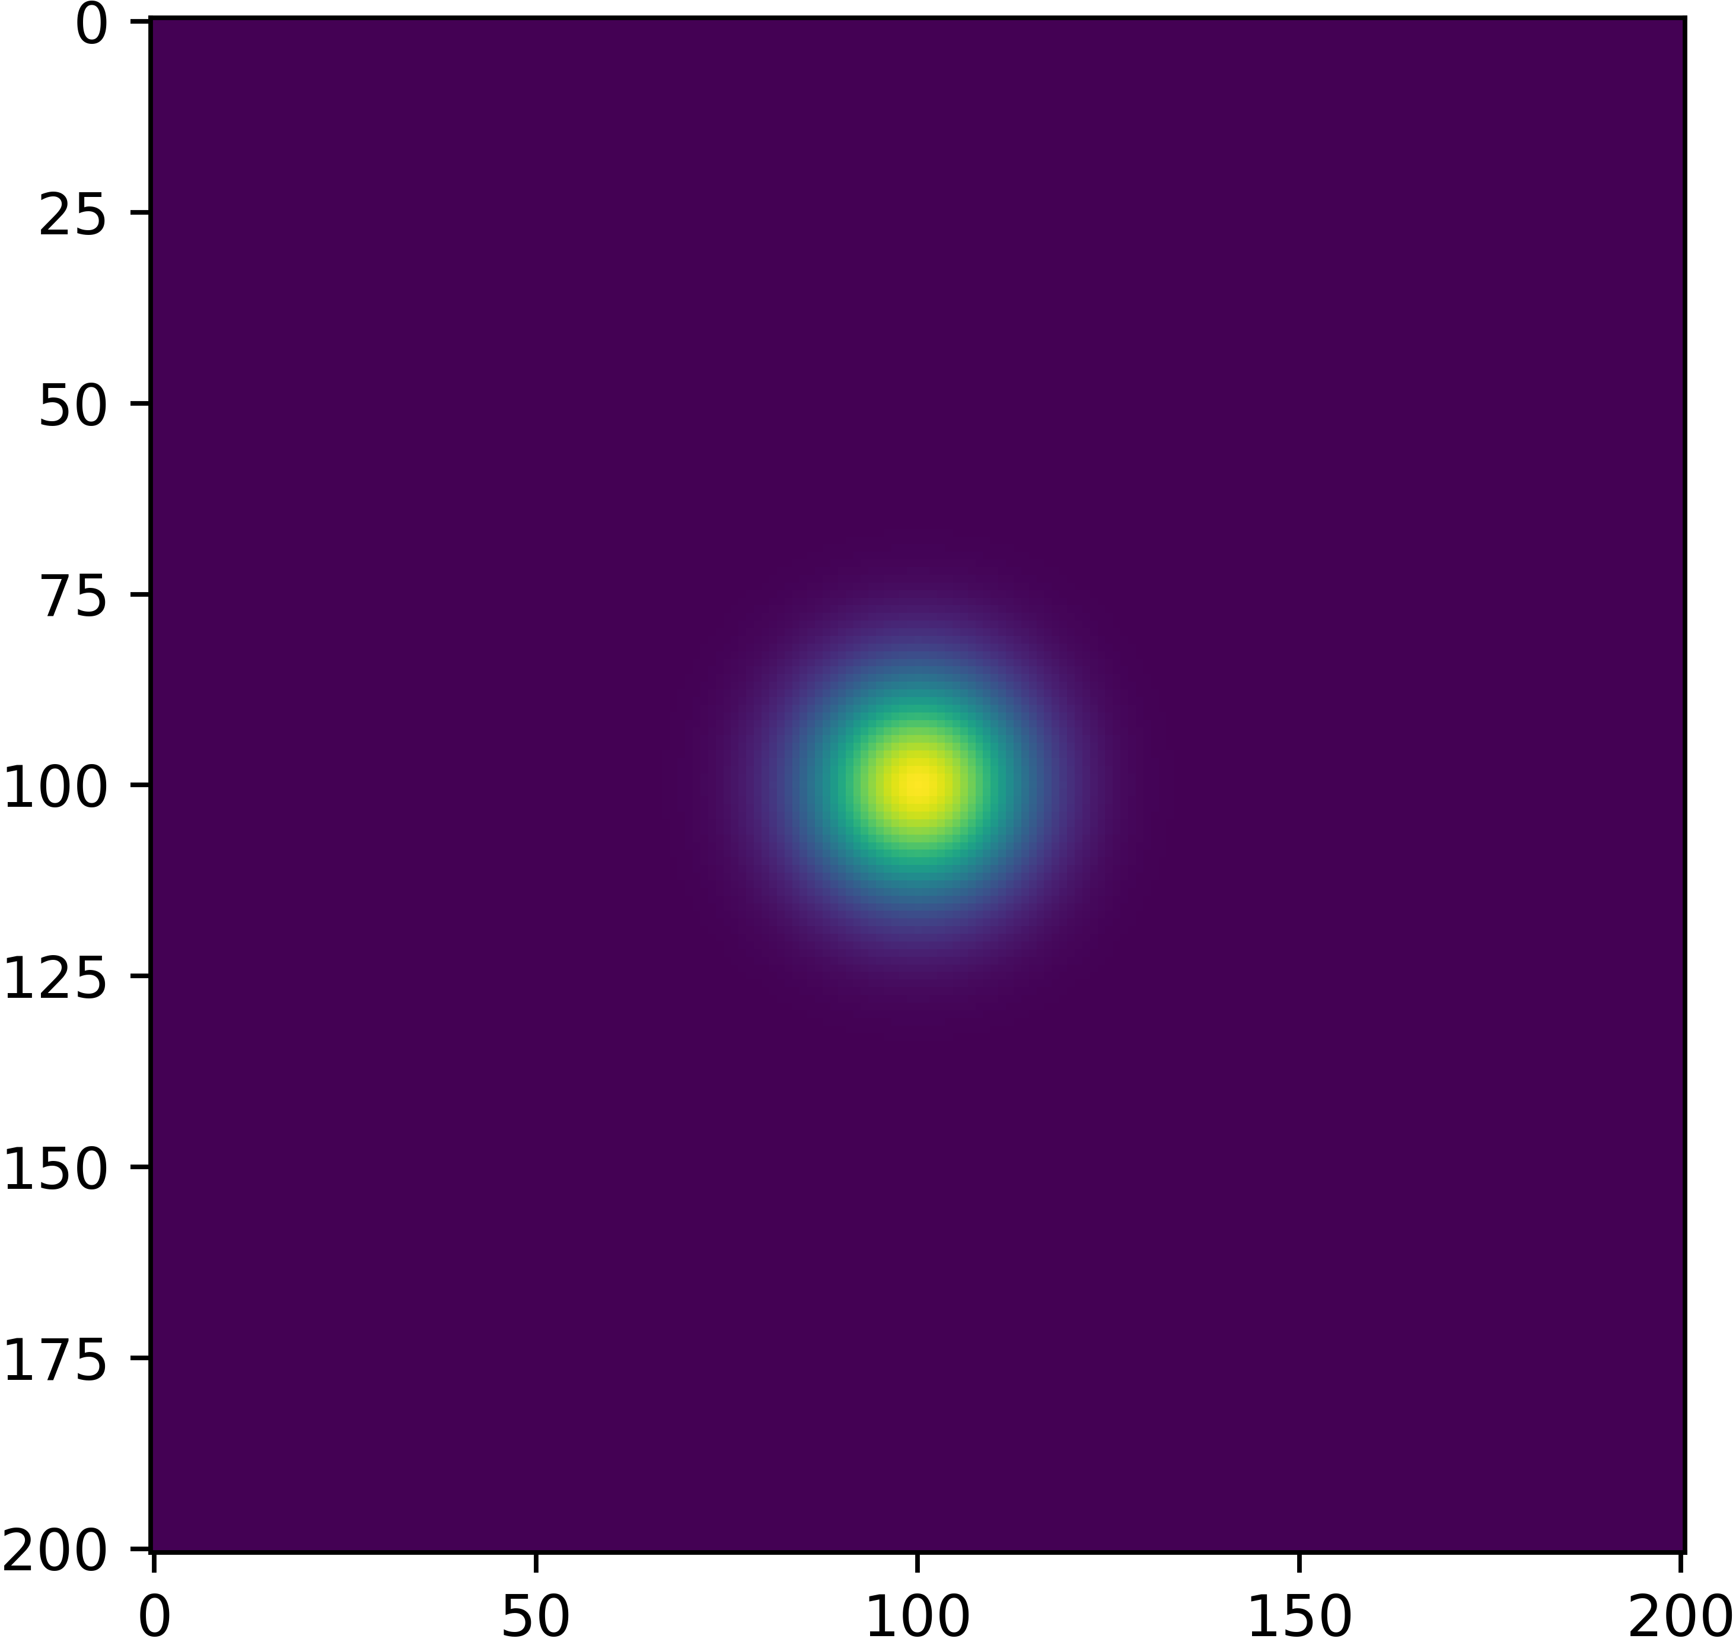
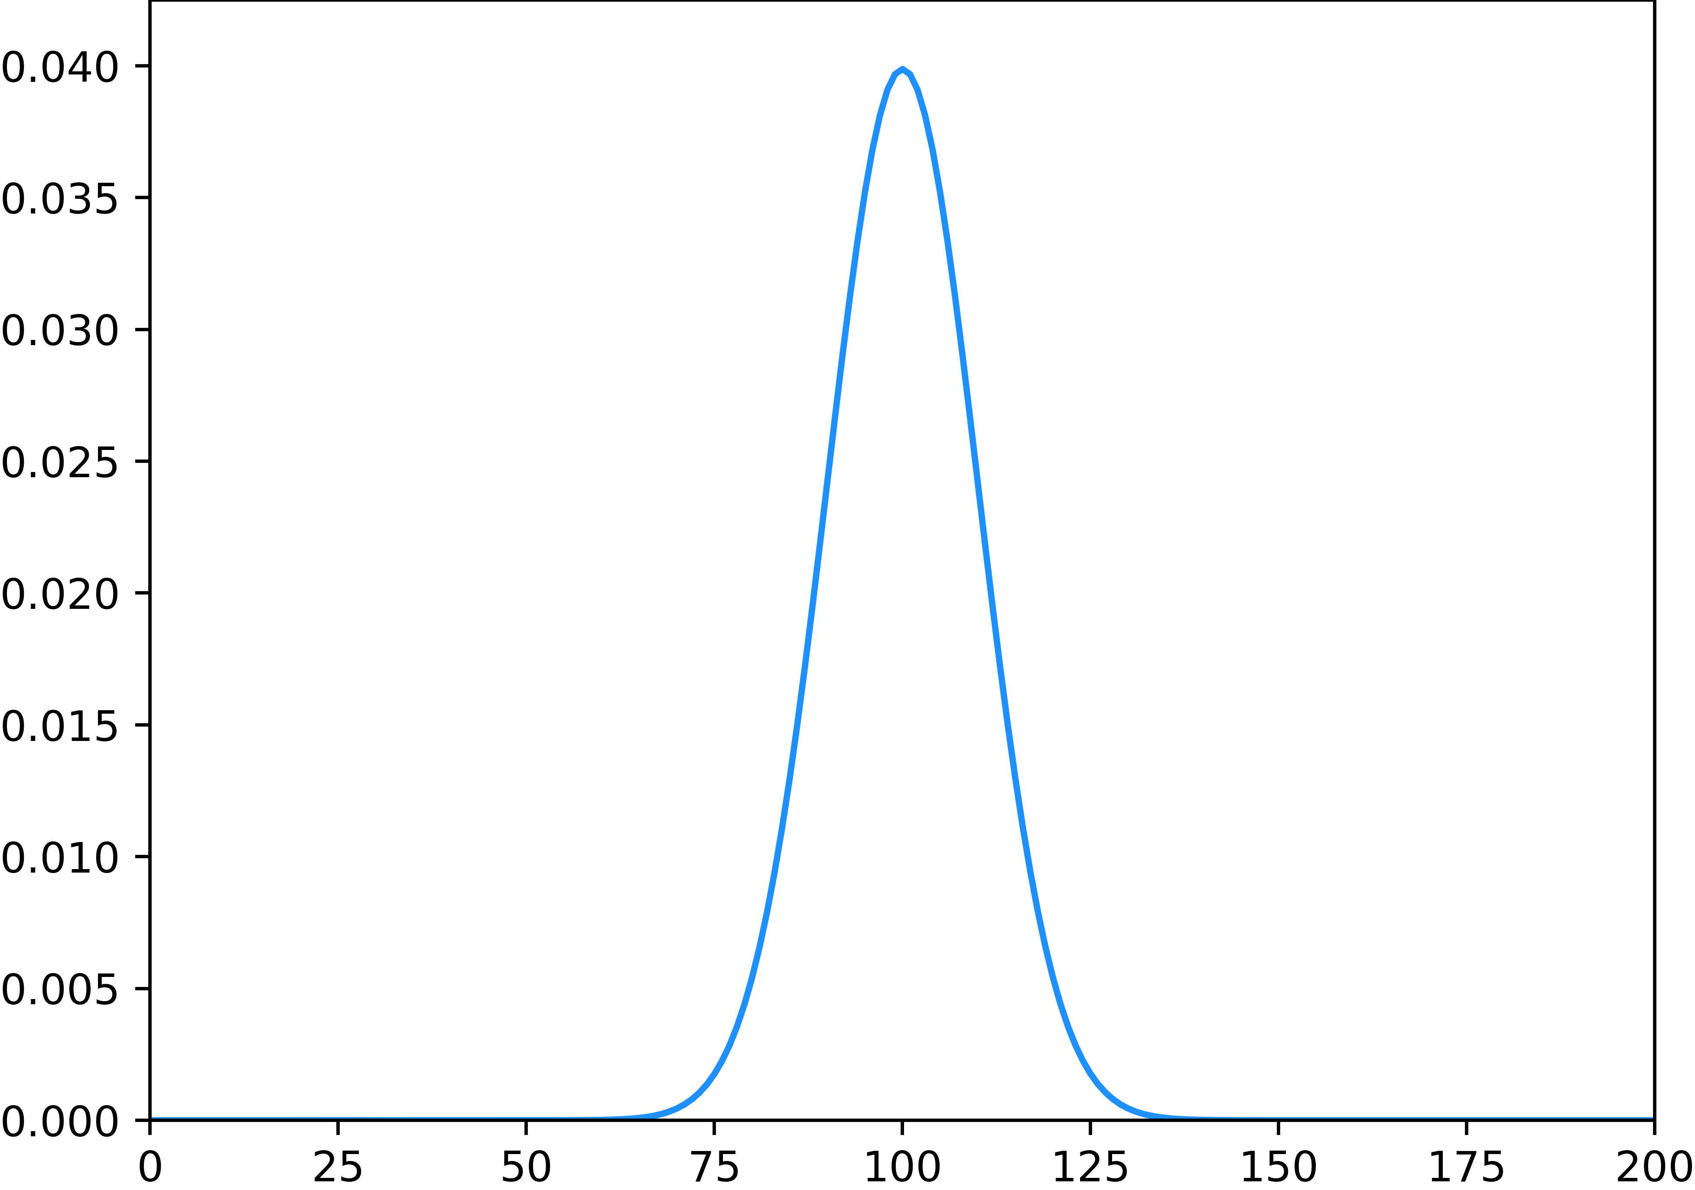
Standard deviation
Consider either the horizontal or vertical deviation of throws.
Use the CDF to calculate the probability within 1mm intervals
We can create a skill kernel by taking the outer product of the two distributions

Slide 31
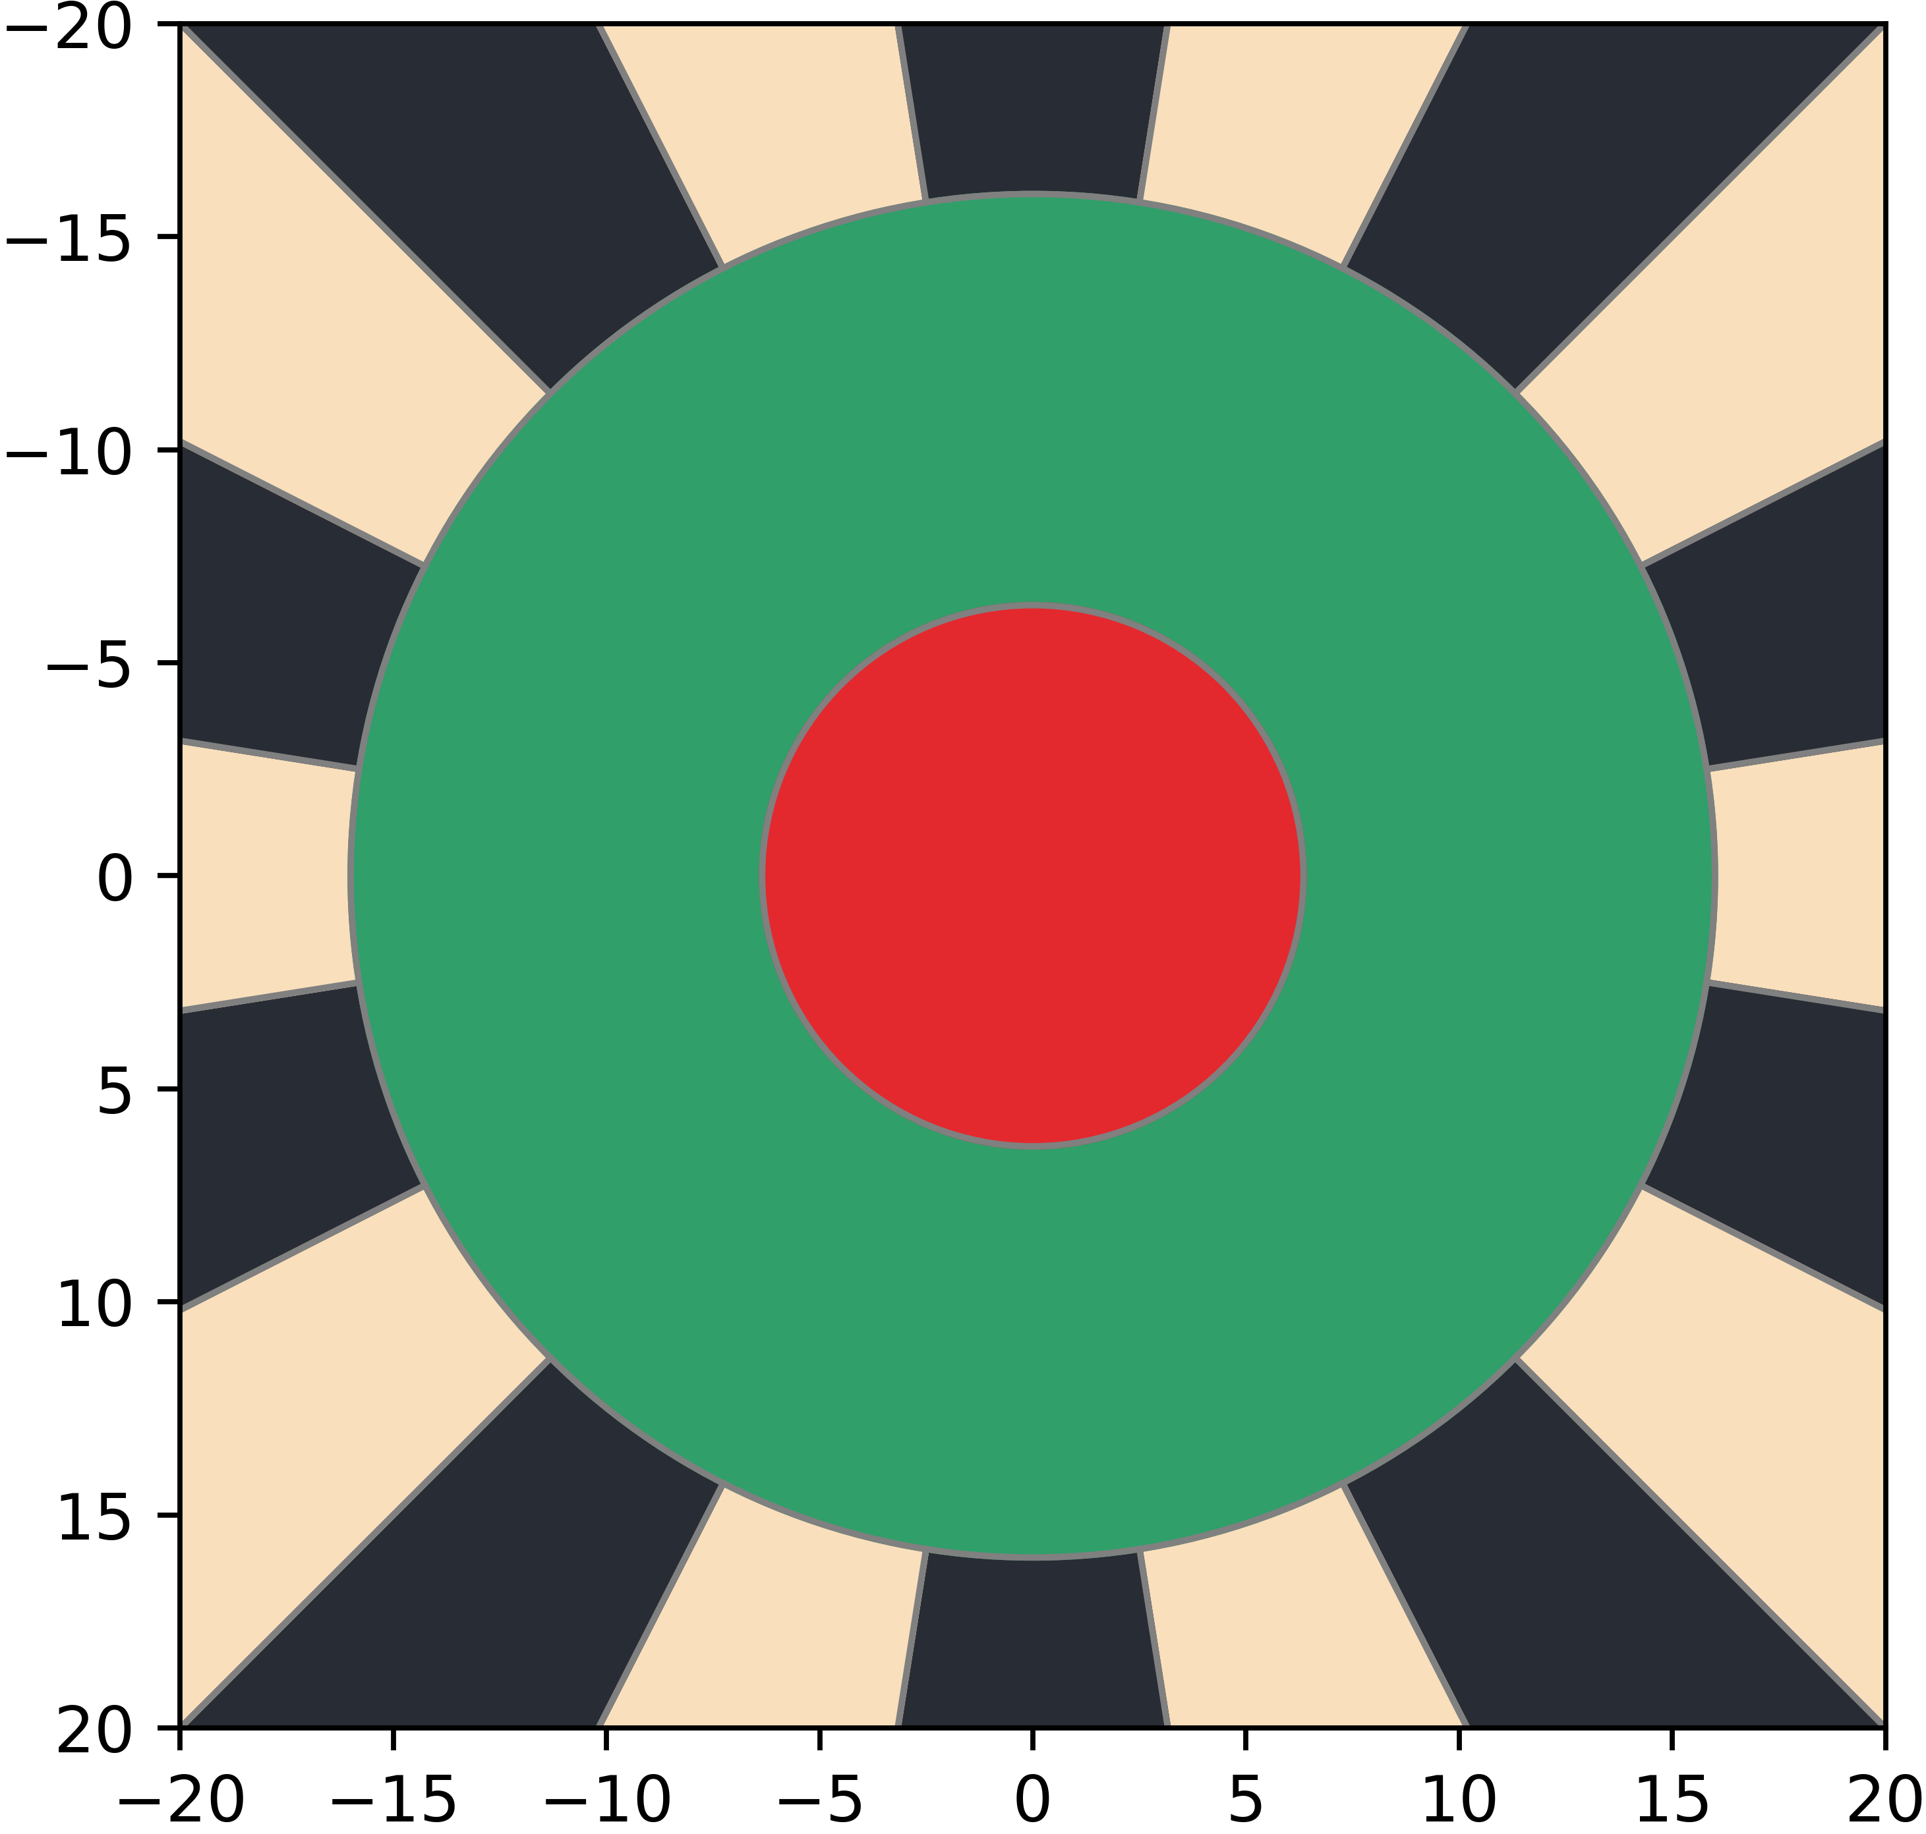

Score Matrix
Divide the board into a grid on a mm scale.

Slide 32
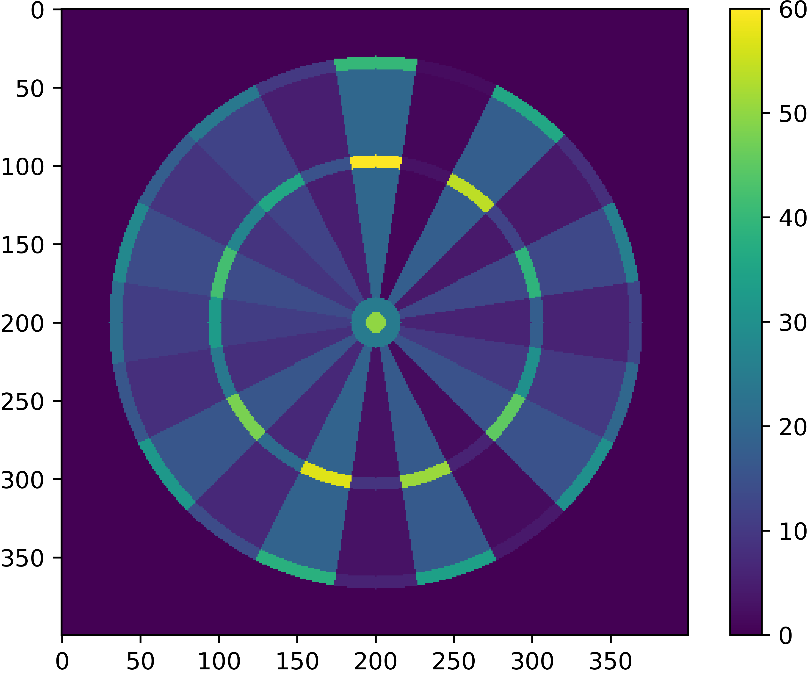
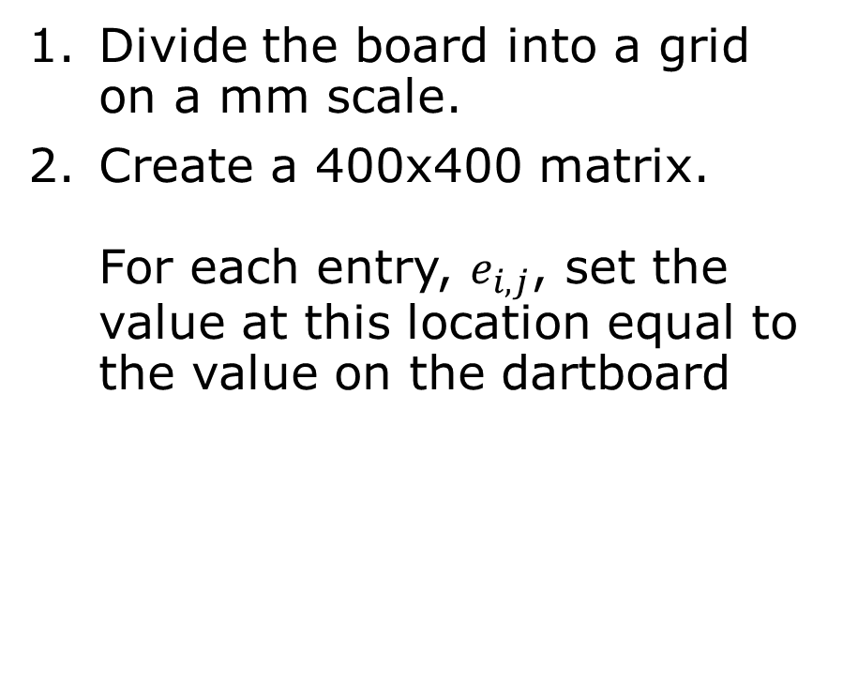
Score Matrix
Divide the board into a grid on a mm scale.
Create a 400x400 matrix. For each entry, $e_{i,j}$, set the value at this location equal to the value on the dartboard

Slide 33



Calculating Expected Value
Perform a 2D convolution of the skill kernel over the board values.
For each point on the board, this calculates the expected value of a player aiming at this location.
Score Matrix
Skill Kernel
Expected Value

Slide 34
Calculating Expected Value (Faster)
We assumed that throw variance is independent in the horizontal and vertical directions.
Therefore, we can perform two 1D convolutions rather than one 2D convolution
Score Matrix
Skill Kernel
Expected Value

Slide 35
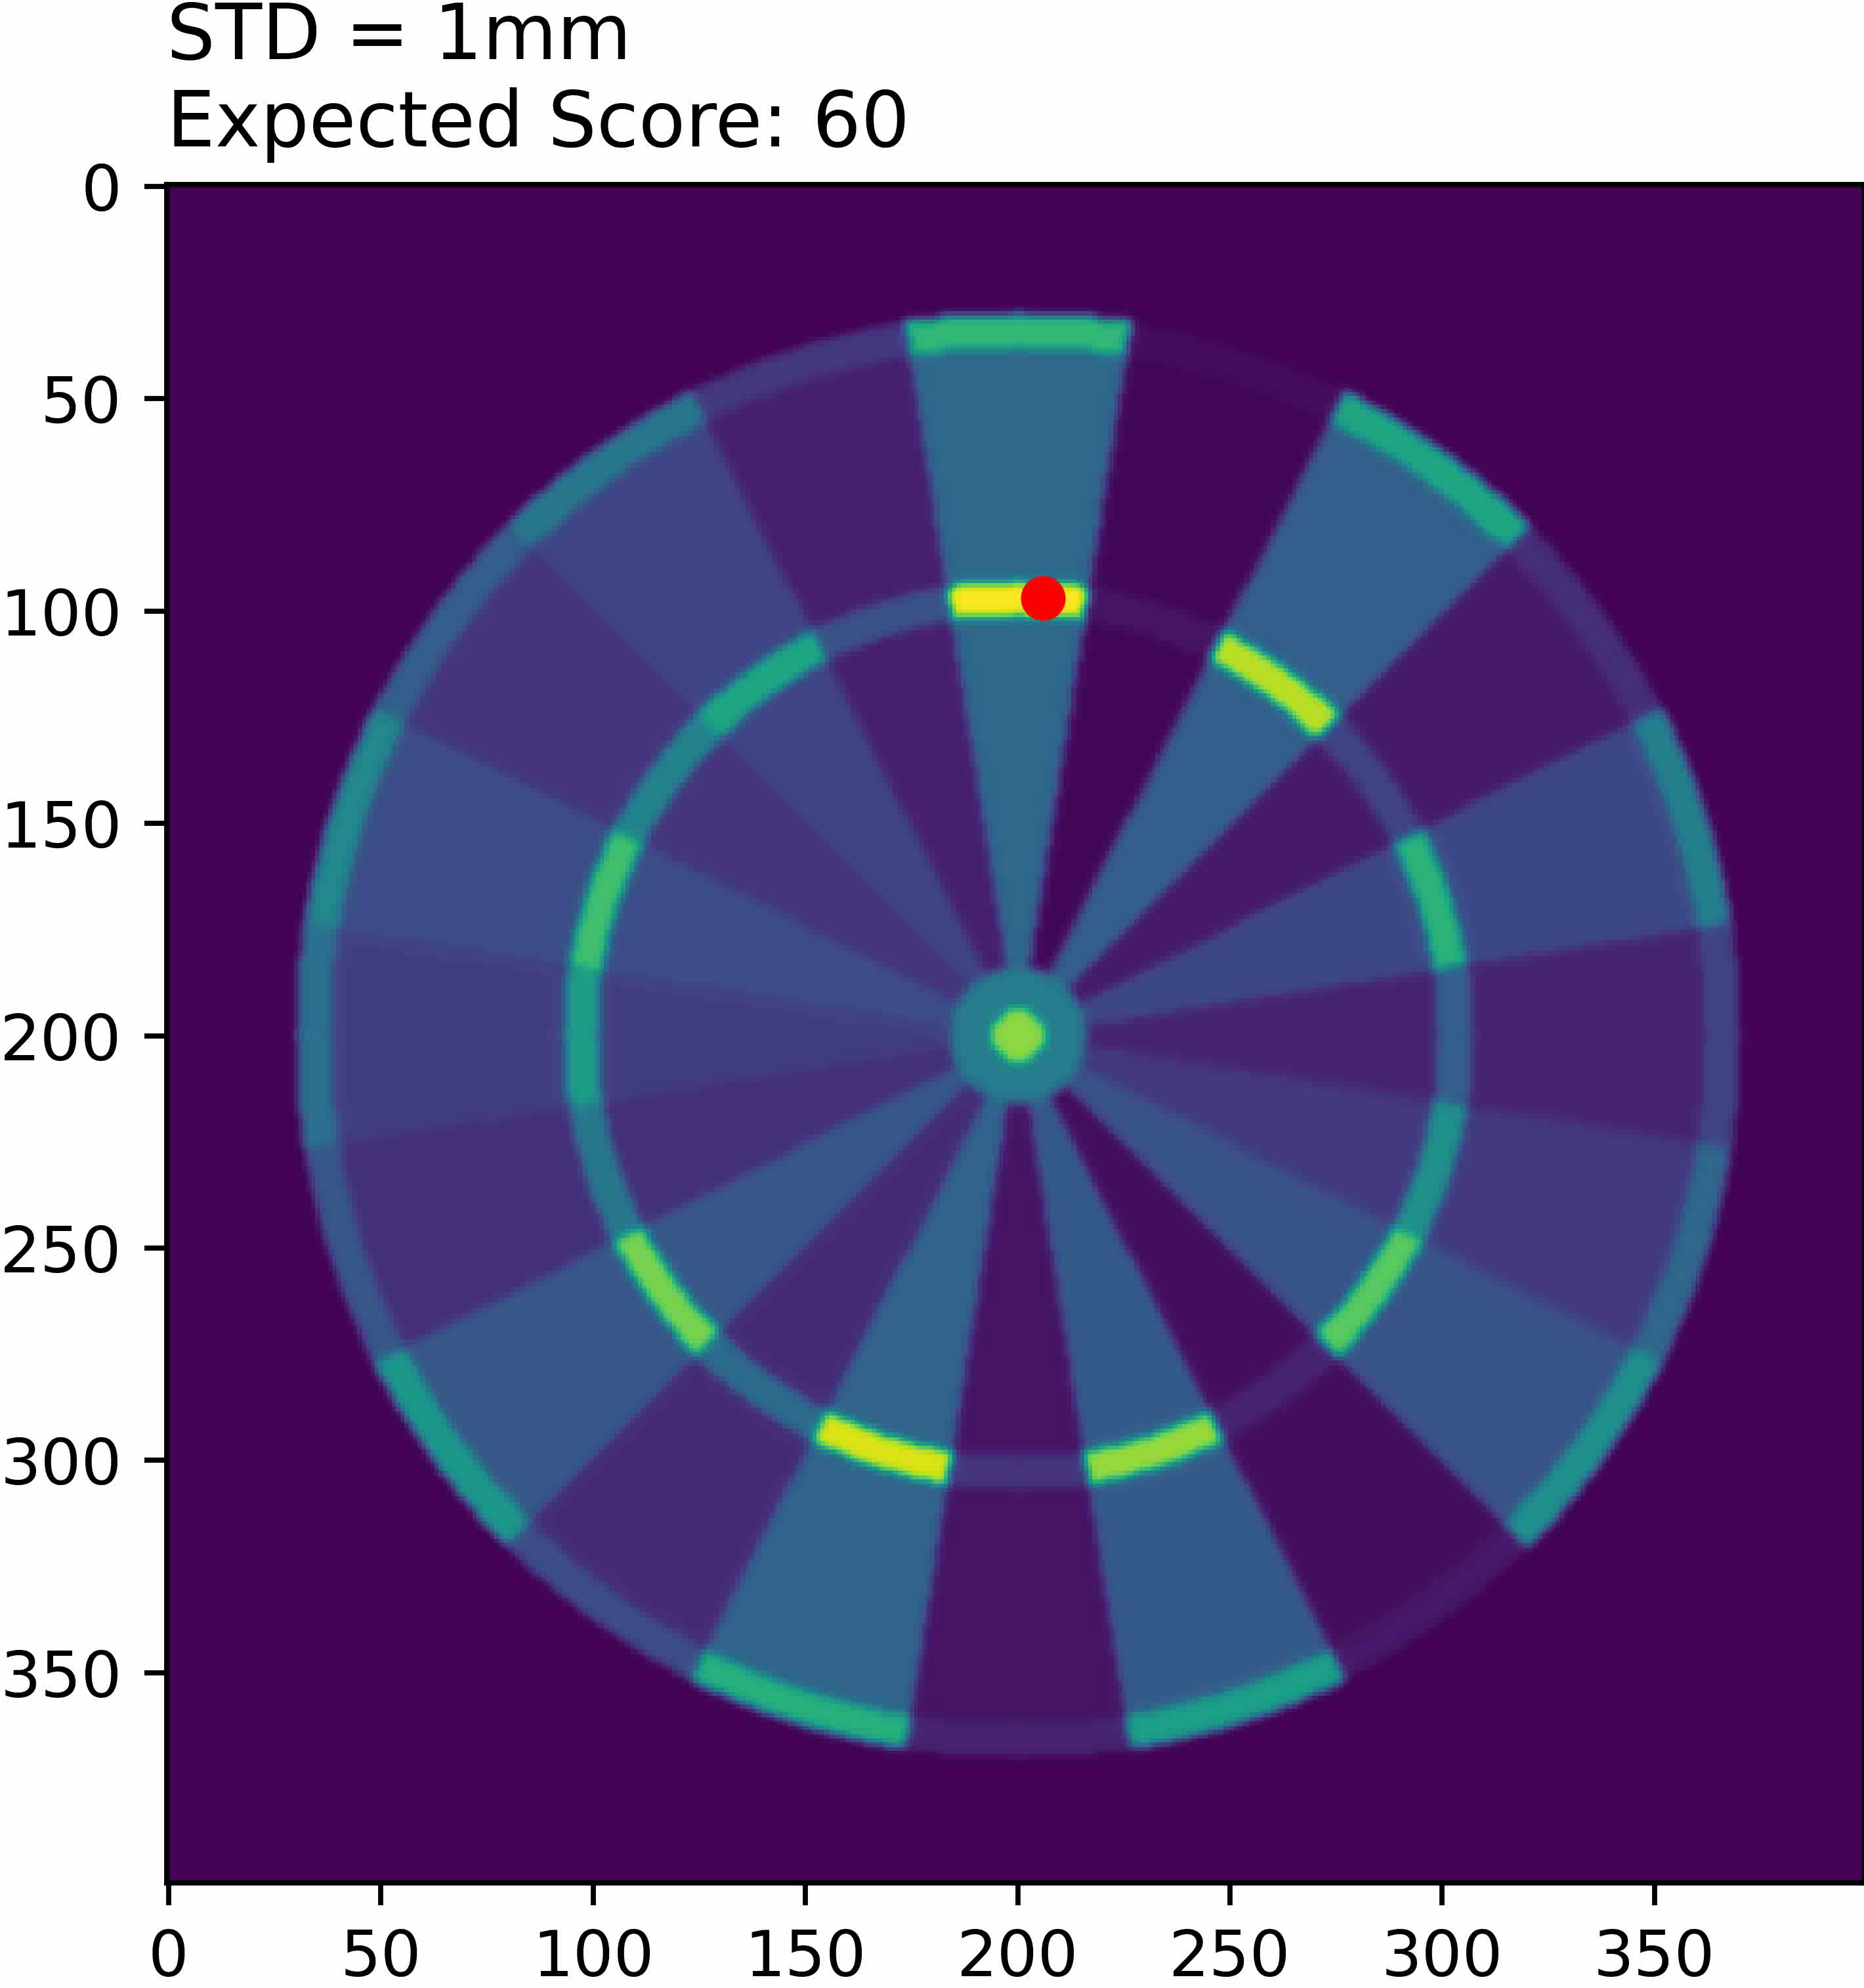
Expected Value
Circular normal distribution with standard deviation ranging from 1mm to 101mm.
The location that maximises the expected score is plotted as a red circle.

Slide 36
Probability of X (DP)
We want to calculate the probability of checking out X in N darts.
And what target location maximises this probability.
Imagine you have 47 remaining, what is your plan?
S15, D16?
S7, D20?
T3, D19?

Slide 37
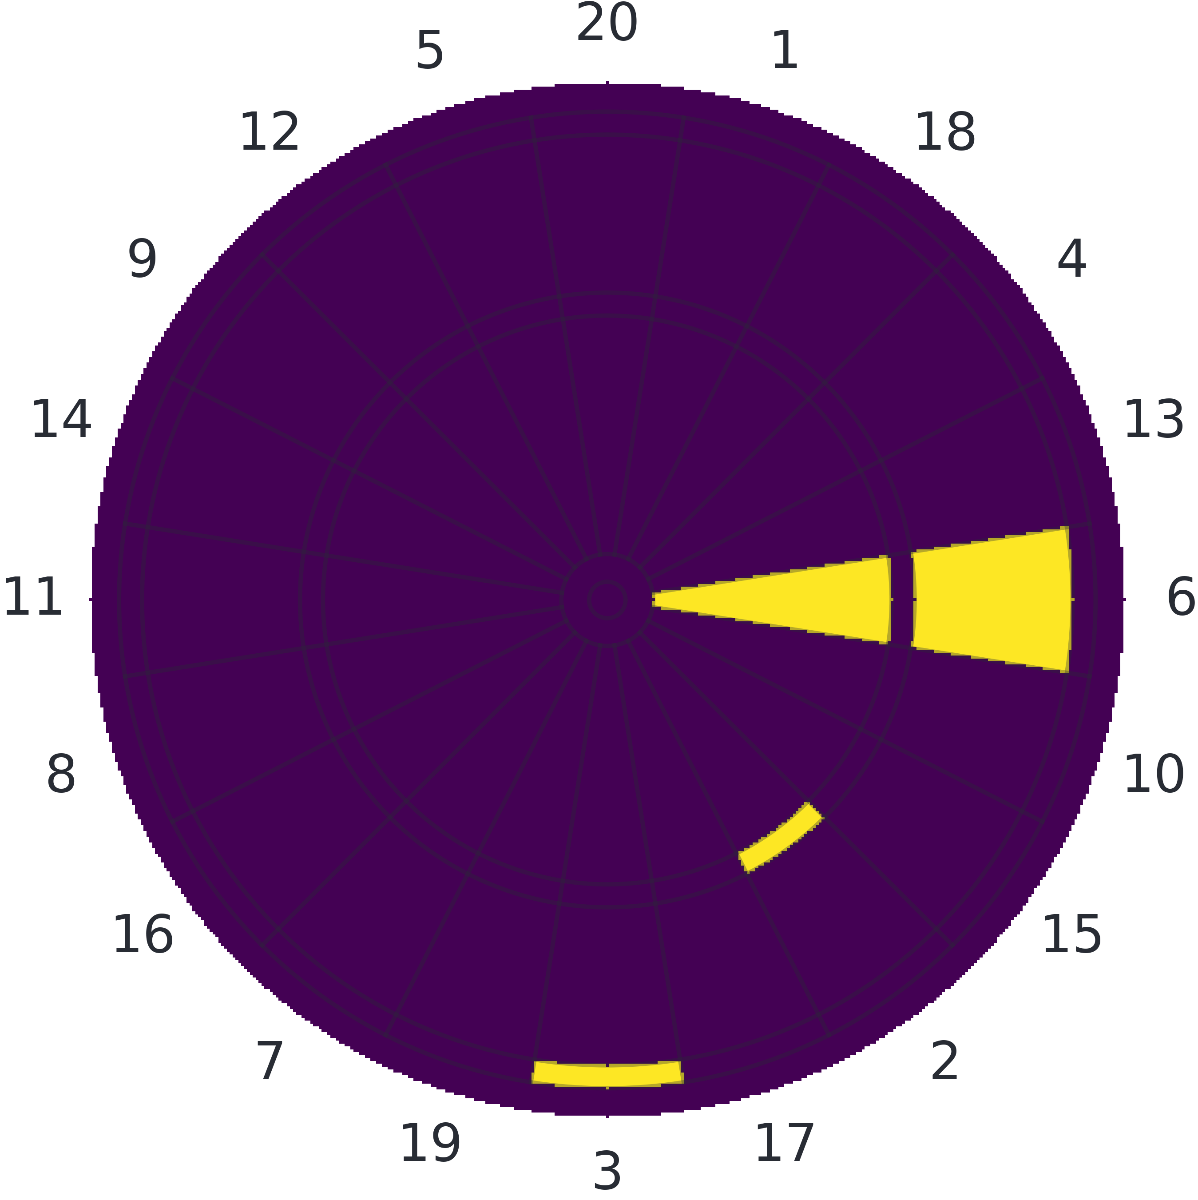
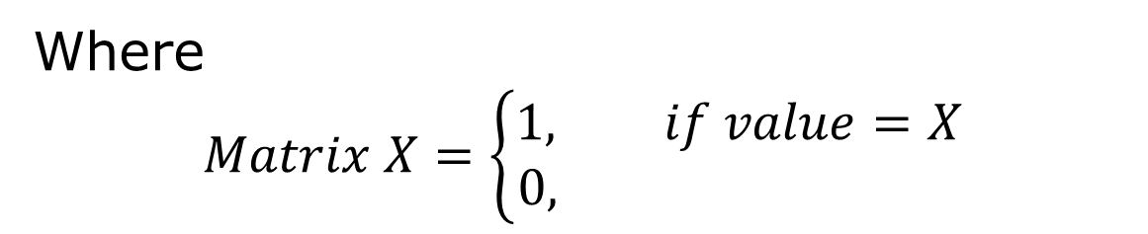
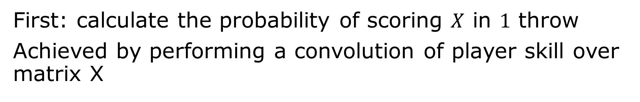
Probability of X (DP)
First: calculate the probability of scoring $X$ in $1$ throw
Achieved by performing a convolution of player skill over matrix X
Where
$$Matrix X=\left\{\begin{aligned}1, if value=X \\ &0, \end{aligned}\right.$$

Slide 38
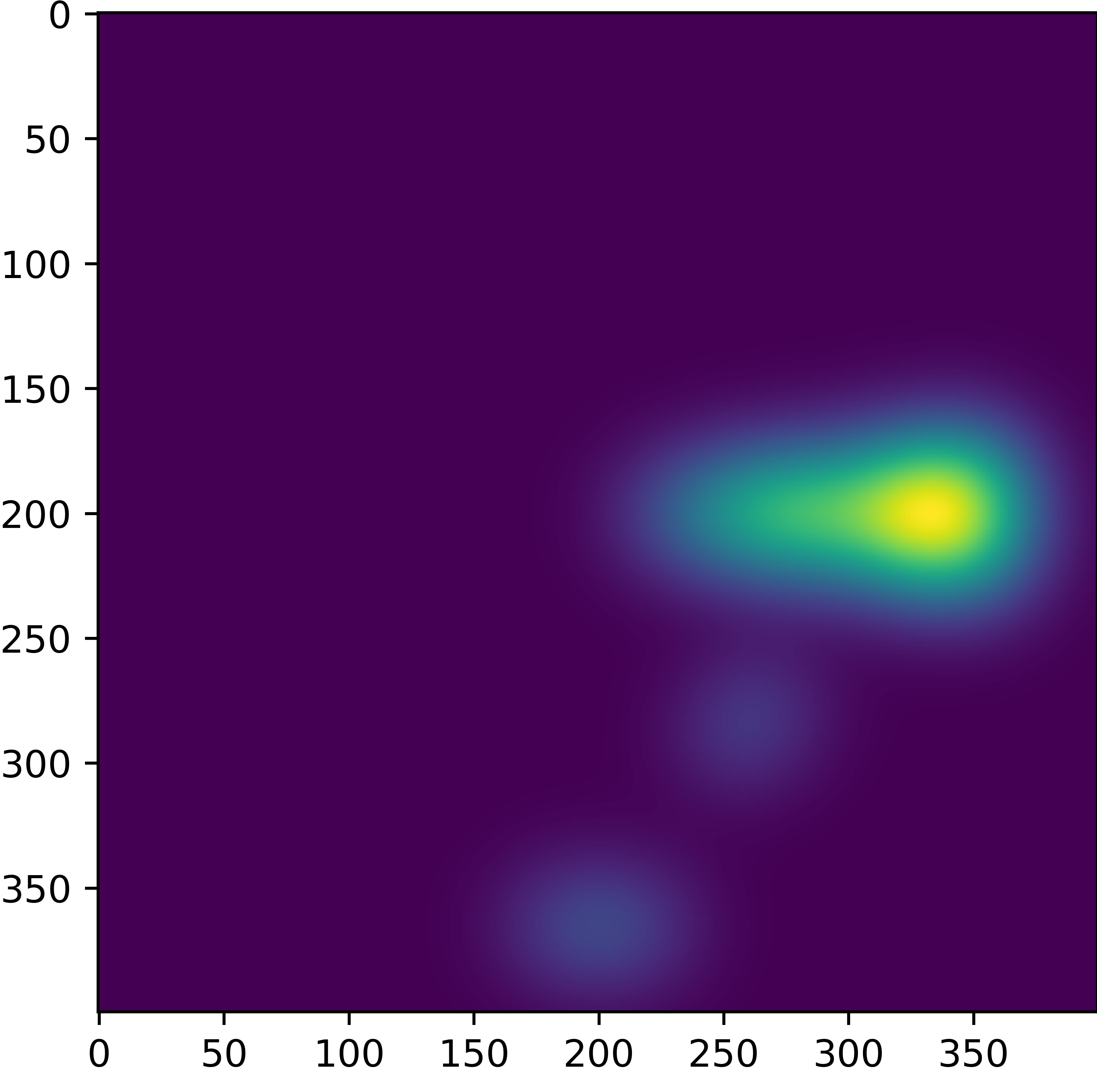
Probability of X (DP)
First: calculate the probability of scoring $X$ in $1$ throw
Achieved by performing a convolution of player skill over matrix X
$X=6$
Probability of scoring $X$ in $1$ dart

Slide 39
Probability of X (DP)
Function checkout_probabilities(darts: n):
For each total that can be checked out in n darts:
Calculate the probability of hitting a double for total
Initialize probabilities to that probability
For each possible score in 1 dart:
Calculate the probability of hitting score
Calculate the probability of checking out total-
score in n-1 darts
Add the product to probabilities
Save the maximum probability to a lookup table

Slide 40
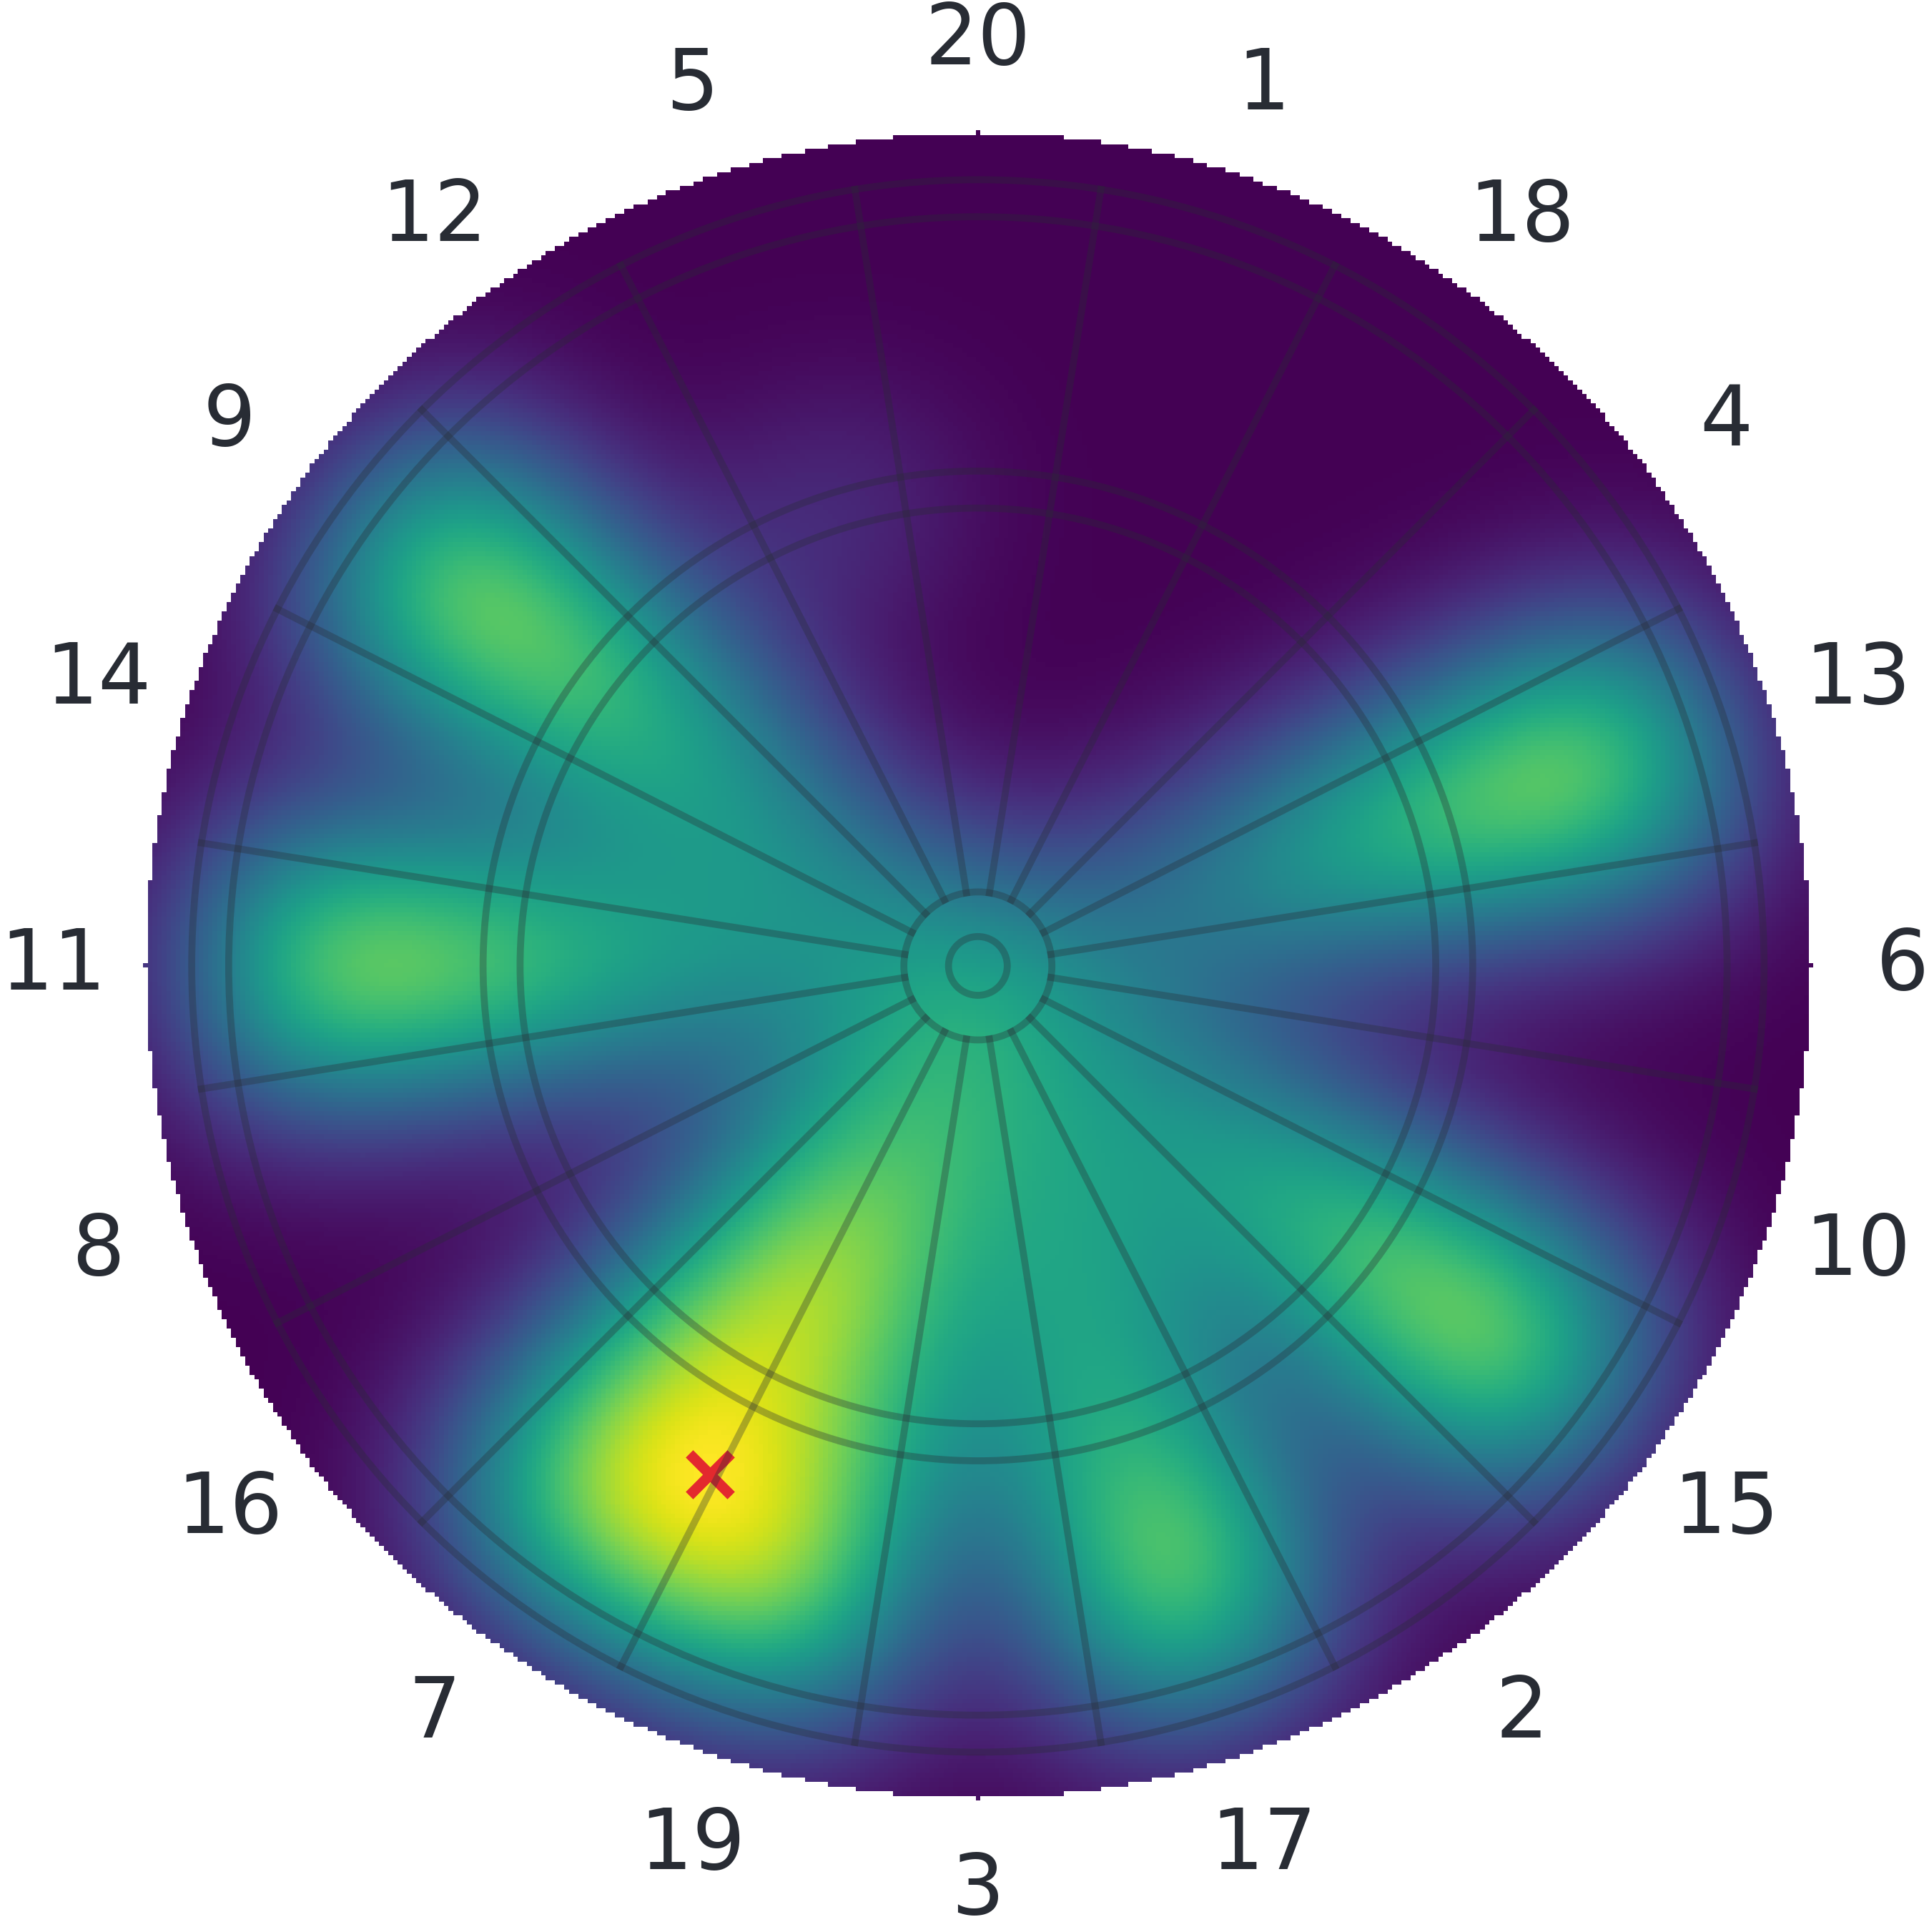
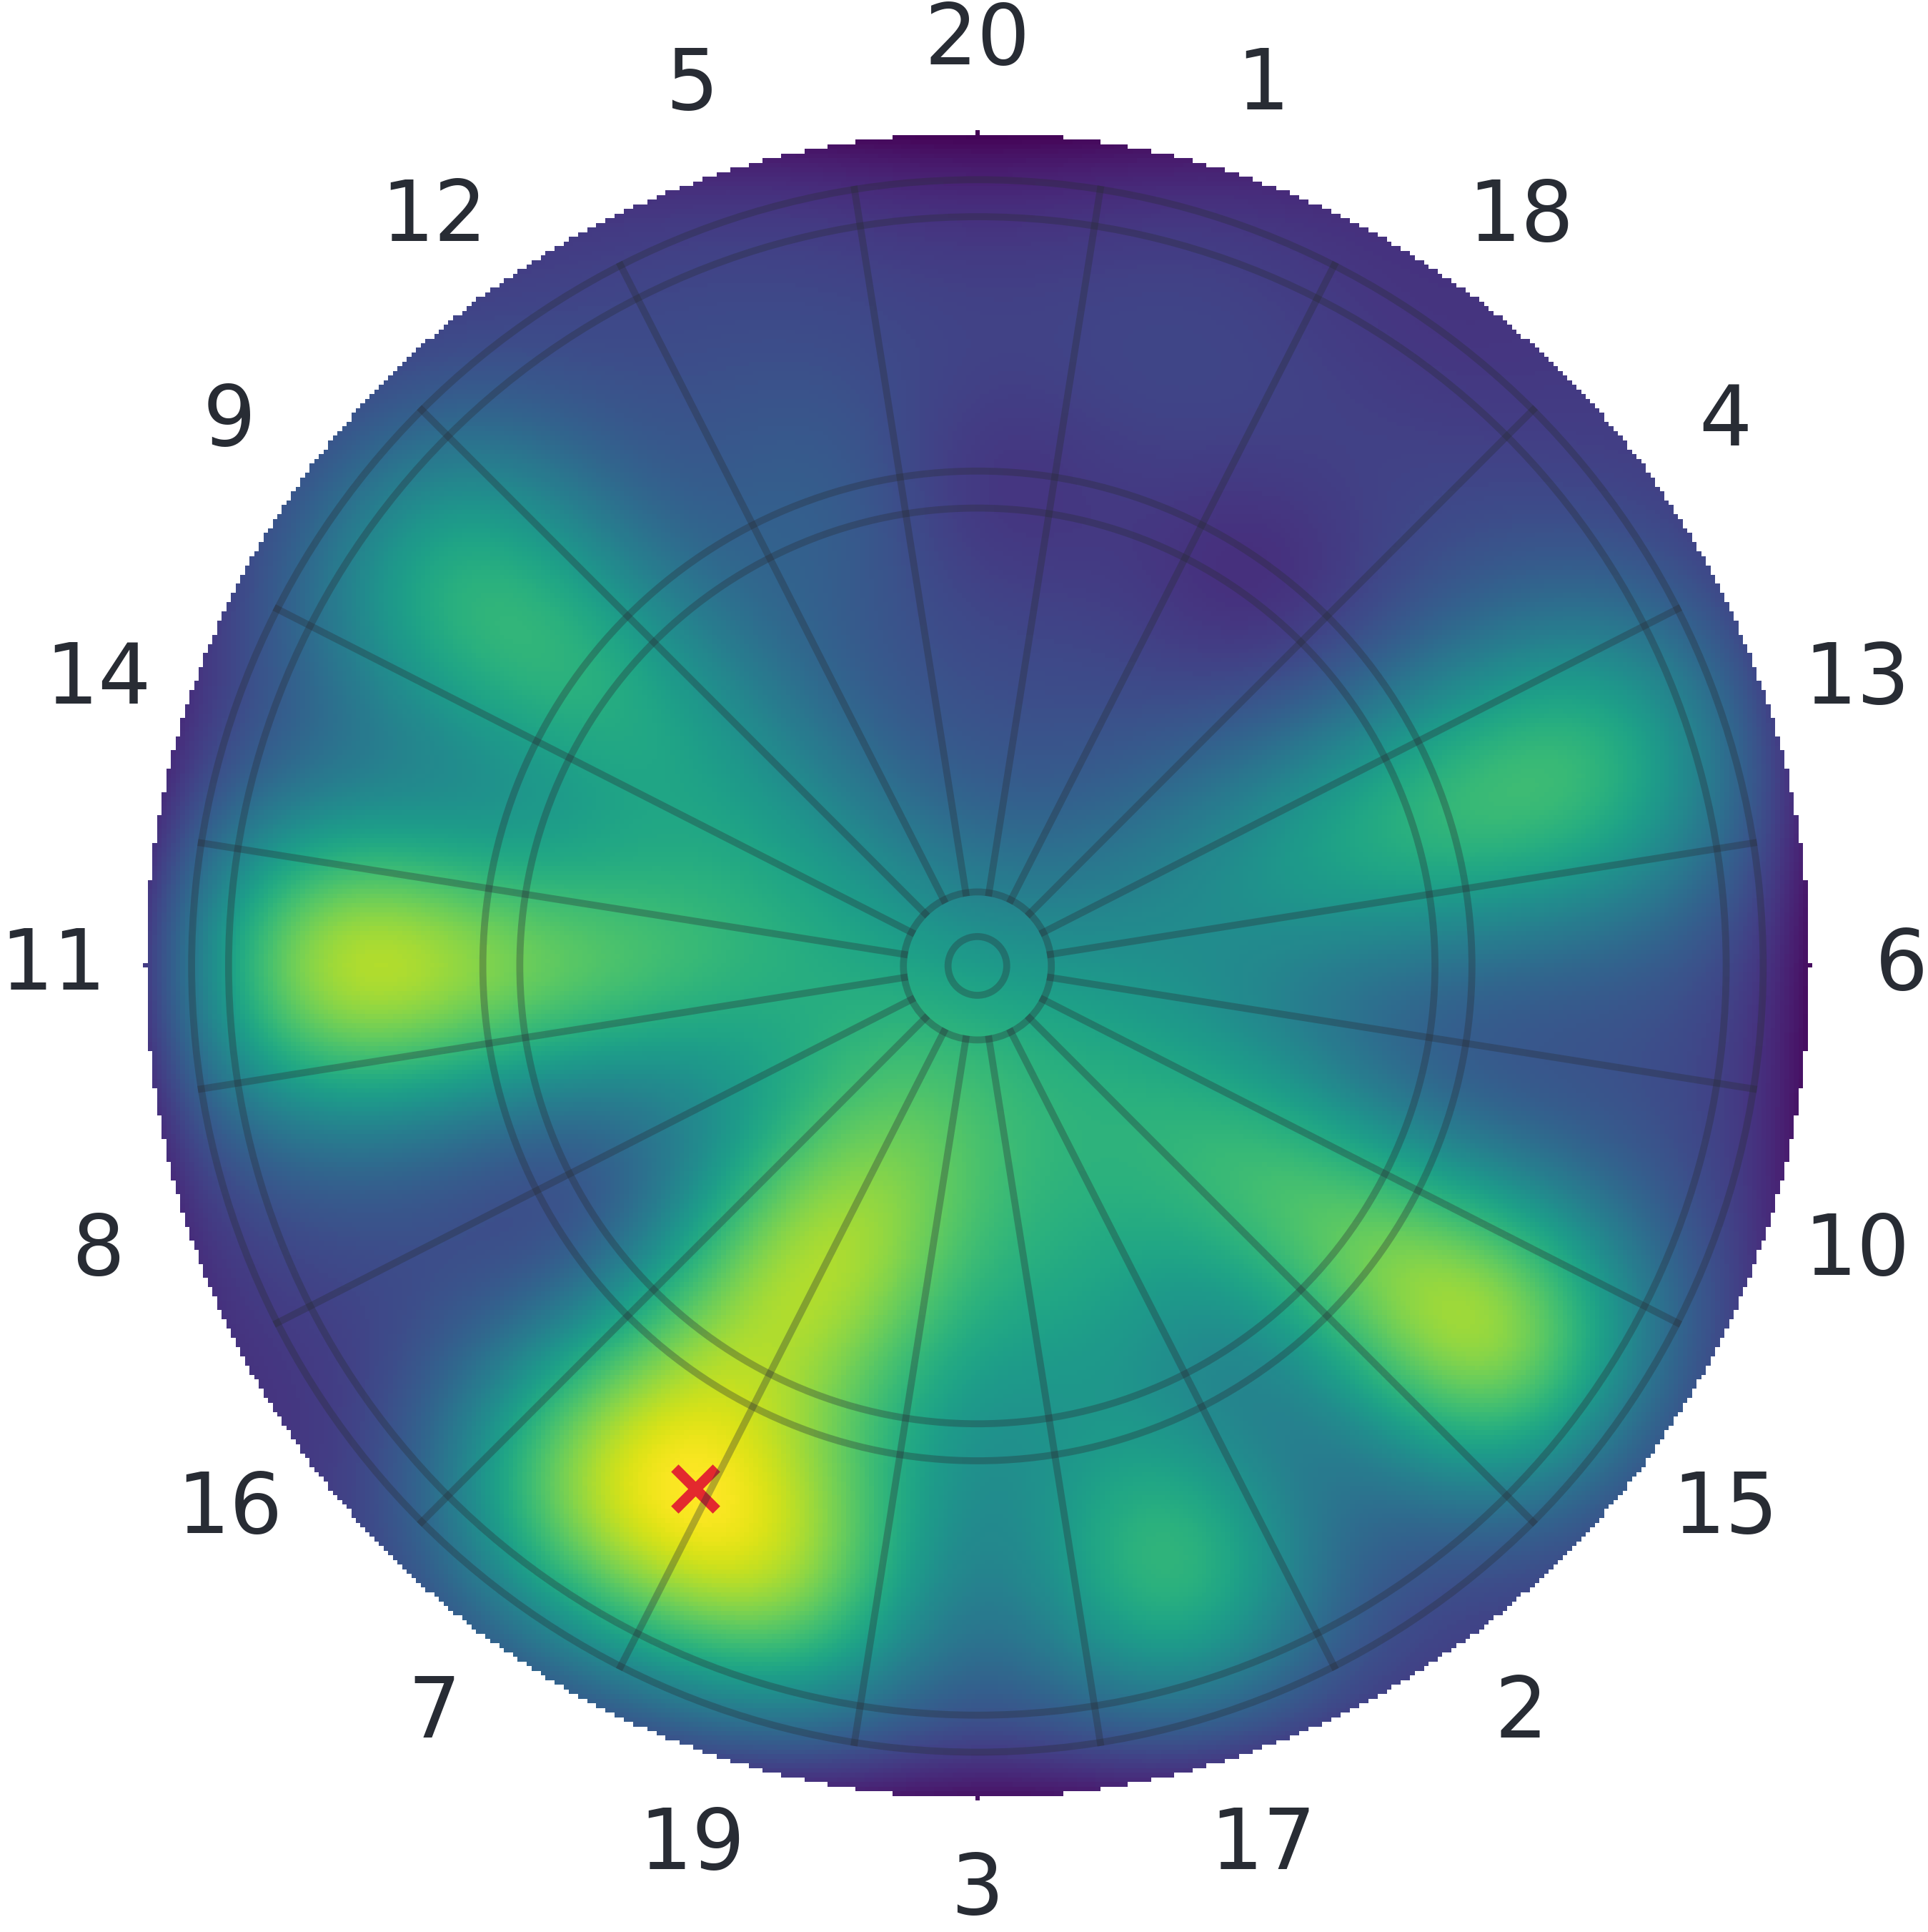
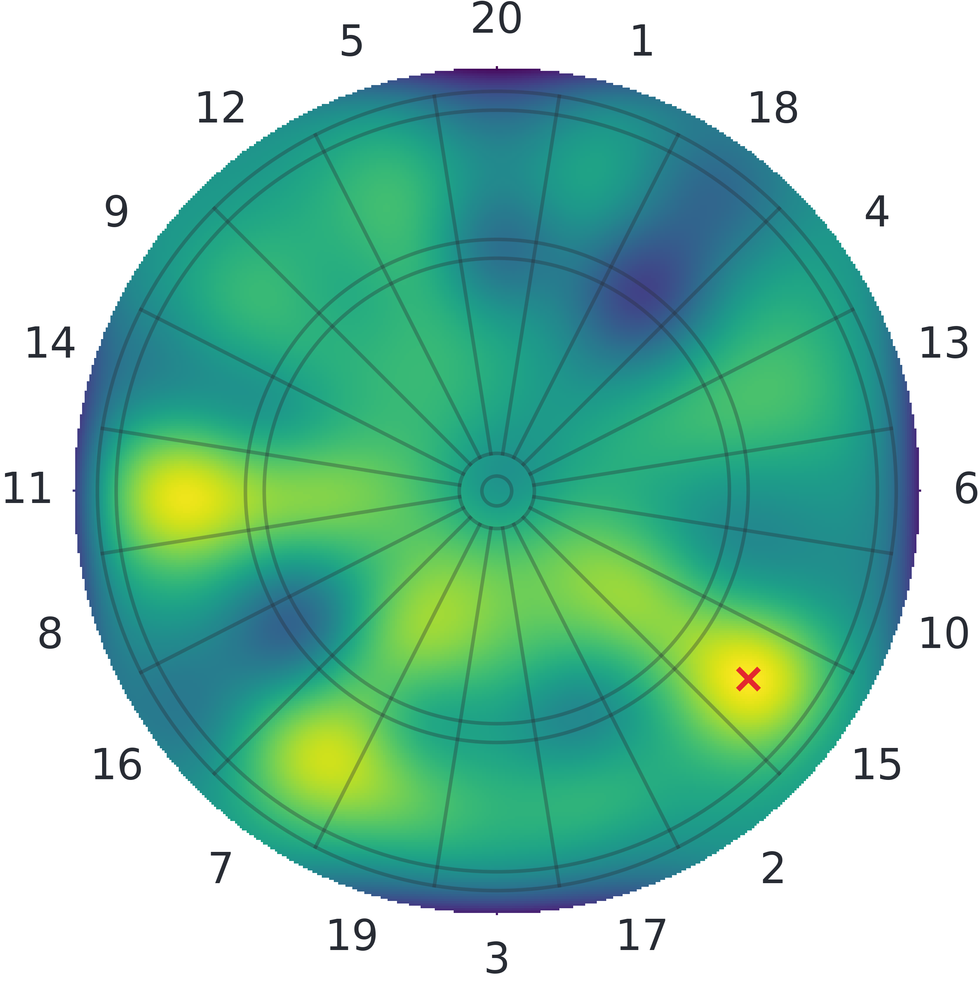

Probability of X (DP)
With $47$ remaining, the model suggests these target locations (for a player with $std=20mm$)
2 darts
3 darts
6 darts

Slide 41
Evaluation
90% correct classification. (84/94)
Blue regions are incorrectly scored.
Solution: Change camera mounts.

Slide 42
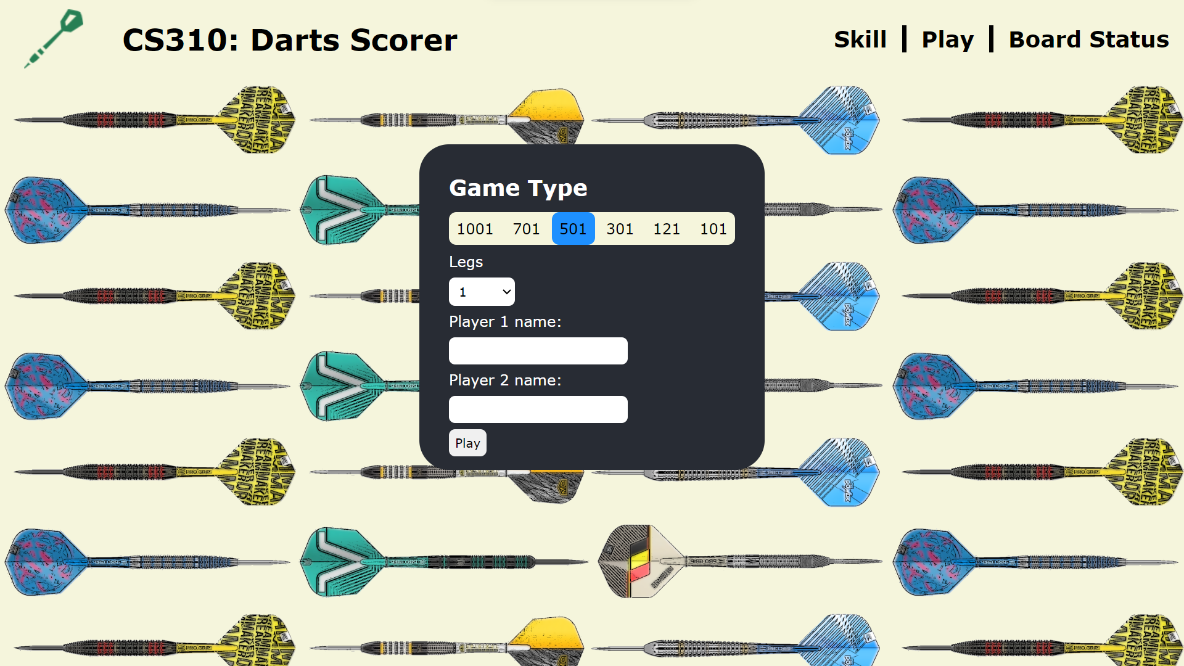
DEMO

Slide 43
Questions

Slide 44
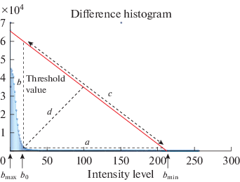
Thresholding
Global (One threshold value for the whole image)
Local (Adaptive values based on surrounding pixels)
Triangle Method

Slide 45
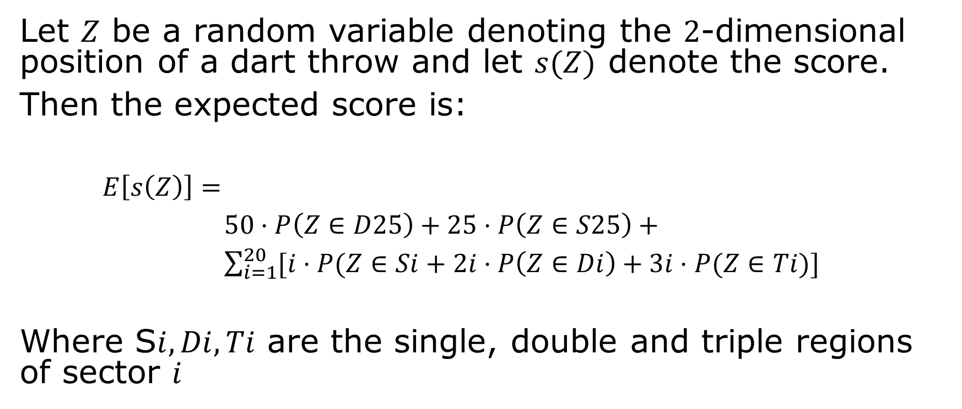
Calculating Expected Value
Let $Z$ be a random variable denoting the $2$-dimensional position of a dart throw and let $s(Z)$ denote the score.
Then the expected score is:
$E\left[s\left(Z\right)\right]=$
$50⋅P\left(Z∈D25\right)+25⋅P\left(Z∈S25\right)+$
$\sum_{i=1}^{20}{[i⋅P(Z∈Si+2i⋅P\left(Z∈Di\right)+3i⋅P(Z∈Ti)]}$
Where S$i,Di,Ti$ are the single, double and triple regions of sector $i$
https://www.stat.cmu.edu/~ryantibs/papers/darts.pdf

